Slide 1
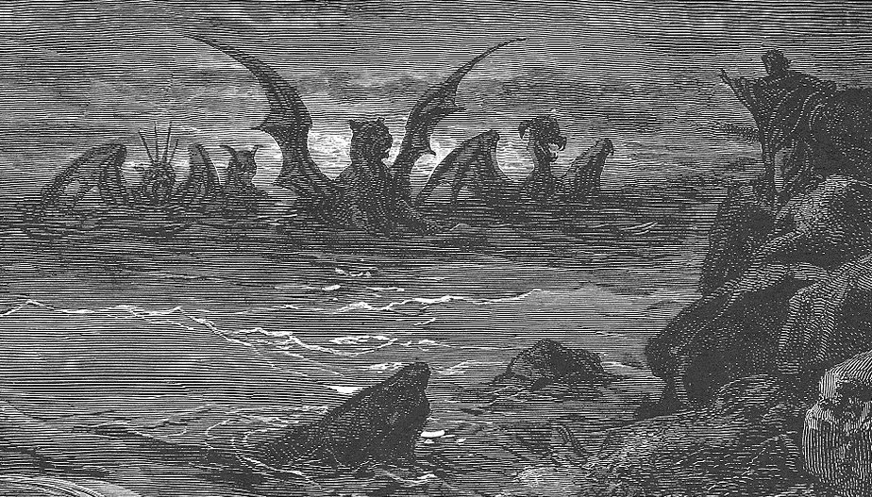
Vision of the Four Beasts
and the Eternal Dominion
of the Son of Man
Daniel 7
W. Cochran
wayne.cochran@gmail.com

Slide 2
Chronology of
The Book of Daniel
Jeremiah
70 Years (Jeremiah 25:8-14)
70 = 490/7 years of Sabbaths for the land (2 Chronicles 36:21)
Darius
(Medes)
Nebuchadnezzar
Evil-Merodach
…
Belshazzar
Cyrus
(Persians)
586
539
605
first
deportation
562
553
535
return under
Zerubbabel
Ezekiel
553 BC
Four Beasts
Little Horn
Ancient of Days
(Ch 7)
585 BC
Fall of Tyre
605 BC
Daniel refuses
delicacies
(Ch 1)
538-534 BC
Lion’s Den
(Ch 6)
587 BC
Golden Image
Fiery Furnace
(Ch 3)
571-562 BC
Nebuchadnezzar’s
judgment
(Ch 4)
551 BC
Ram & Goat
(Ch 8)
603 BC
Great Statue
(Ch 2)
539 BC
Writing on Wall
70 Weeks
(Ch 5, 9)
~534
Kings N/S
Time of End
(Ch 10-12)

Slide 3
Chiasmus of Daniel 2 - 7
Daniel 2:4b-7:28 is written in Aramaic not Hebrew
A : Dream of four kingdoms replaced by a fifth (Ch 2)
B : Daniel’s three friends in fiery furnace (Ch 3)
C : Daniel’s interpretation of dream for Nebuchadnezzar (Ch 4)
C : Daniel’s interpretation of handwriting on wall for Belshazzar (Ch 5)
B : Daniel in the Lion’s Den (Ch 6)
A : Vision of four kingdoms replaced by a fifth (Ch 7)

Slide 4
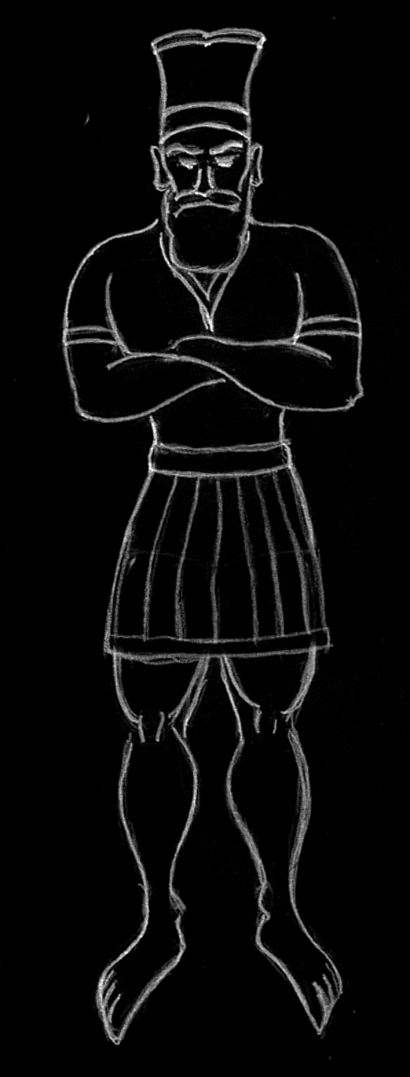
Five Kingdoms of Nebuchadnezzar’s Dream
Daniel 2
GOLD
Nebuchadnezzar
Babylon
SILVER
Media
Persia
Babylon (Nebuchadnezzar v 37, 38)
Media / Persia
Greece
Rome (which becomes divided)
Millennial / Eternal Kingdom
Bronze
Greece
Iron
Rome
break & consume
Iron & Clay
Notes:
Daniel 2 - 7 also forms a chiasmus
A : dream of 4 kingdoms replaced by a fifth (Ch 2)
B : Daniel’s 3 friends in fiery furnace (Ch 3)
C : Daniel’s interpretation of dream for Nebuchadnezzar (Ch 4)
C : Daniel’s interpretation of handwriting on wall for Belshazzar (Ch 5)
B : Daniel in the Lion’s Den (Ch 6)
A : A vision for 4 kingdoms replaces by a fifth (Ch 7)

Slide 5
Kingdoms in Daniel
Kingdom | Nebuchadnezzar’s Dream of Statue Daniel 2 | Daniel’s Vision of Four Beast Daniel 7 | Daniel 8
Babylon | Head of Gold | Lion with eagle’s wings
Media / Persia | Chest and arms of silver | Bear raised up on one side with 3 ribs in teeth | Ram with 2 horns
Greece | Belly and thighs of bronze | Leopard with 4 wings and 4 heads | Goat with 1 horn - horn breaks and 4 horns appear
Rome | Legs of iron Feet of iron + clay | Large iron teeth and 10 horns - little horn removes 3
Millennial | Stone cutout by no human hand | Son of Man is given an everlasting dominion

Slide 6
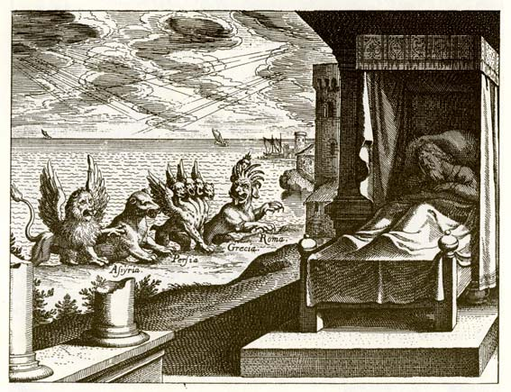
Daniel’s Vision of Four Beasts
Daniel 7:1-8
“beasts came of from the sea” v.2
First beast of Revelation 13 rose “out of the sea”
Lion with wings (v. 4)
Bear (v. 5)
Leopard with four wings and four heads (v. 5)
Beast with iron teeth and ten hounds (v. 7)
Notes:
Great Sea = Mediterranean
Harlot of Revelation 17 was “seated on many waters” (17:1) which are “peoples and multitudes and nations and languages.” (17:15)

Slide 7
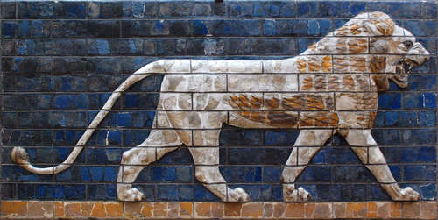
Babylon
Neo-Babylon Empire (626 - 539 BC) defeated Assyrian Empire
Nebuchadnezzar the Lion (605 - 562 BC)
“A lion .. destroyer of nations” Jeremiah 4:7
“wings plucked off” Daniel 4:28-33
“the mind of a man was given to it.” Daniel 4:34
Babylon the Great (as a type of world system) receives wrath from God at the end of the Tribulation (Revelation 14:8, 16:19, 17:5, 18:1,2,10,21)
“Fallen, Fallen is Babylon the Great!” Religious and Political system

Slide 8
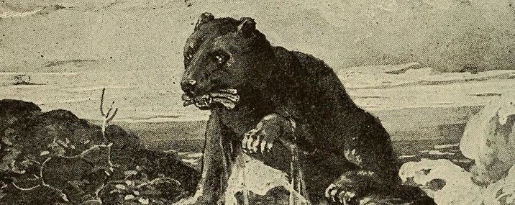
Media and Persia
Persian Empire (539 - 331 BC)
Bear : voracious and cruel “arise, devour much flesh”
“raised up one one side” superiority of Persians,
“three ribs” conquered kingdoms (possibly Egypt, Lydia, and Babbylon?)
Judgement of Babylon Jeremiah 50, 51. Medes Jeremiah 51:48.
Bible records Darius the Mede first entering Babylon (Daniel 5:30) when in fell to the Persian in 539 BC.
Belshazzar’s feast foretells of the defeat of the Babylonians (Daniel 5)
It was under Darius rule that Daniel was placed in the Lion’s Den (Daniel 6).
Babylon surrendered to Cyrus the Great in 539 according to secular historians.
Darius the Great rules the empire at its peak

Slide 9
Greece
Leopard with four wings: swift predator
Alexander the Great became king at 20 years of age (336 BC) and spend most his years in military campaigns and was undefeated in battle. At 30 years of age he had created an empire that extended from the Adriatic Sea to the Indus River.
Defeated the Persian King Darius III in 336 BC
Alexander suddenly died in Nebuchadnezzar’s palace in 323 BC at the age of 32.
“four heads” : empire was divided between four generals: Cassander, Ptolemy (Egypt), Antigonus, and Seleucus (Syria)
The Syrian wars between the Seleucid Empire and the Ptolemaic kingdom is the subject of Daniel 11. Seleucid King Antiochus IV Epiphanes, the great persecutor of the Jews, will desecrate the Temple and bring the rise of the Maccabean Revolt.

Slide 10
The Fourth Beast
The fourth beast is sometimes tied to Syria, but the next great kingdom to rise is Rome.
The Iron Age followed the Bronze Age and Rome heavily used iron in armor and weaponry and alloyed it with carbon to make steel.
Even though Rome was founded centuries earlier, they did not became a world power until they defeated Greece in the middle of the second century BC. Julius Caesar was the first dictator in 45 BC. The Roman Empire begins when Augustus declares himself Emperor in 27 BC.
The 10 Horns and the little horn that subdues three kings : Daniel 7:23-25
Notes:
Bronze is made from allowing Copper with tin or arsenic (and other metals such as aluminum, manganese, nickel, or zinc).
Romans could make steel by hammering wrought iron repeatedly heated in a charcoal fire. Doing so would result in the proper amount of carbon in the iron on the outer surface of the hammered piece.
Forges needed to reach temperature over 1100 degrees C (2012 degrees F).

Slide 11
The Heavenly Court
Daniel 10:9-14
The Ancient of Days and the heavenly court (v. 9-10)
The fourth beast is slain and the remaining beasts have their dominion taken away (v. 11-12)
Son of Man is given dominion (v. 11-14)
Jesus before Caiaphas (Matthew 26:24)
Kingdom of Christ is ushered in

Slide 12
The Fourth Beast
Great iron teeth (v. 7) and bronze claws (v. 19).
Devoured, broke and pulverized the whole world (v. 23).
10 horns = four kings (v . 17, 24)
Another king will arise, different then the others, and will put down three of the kings.
He will blaspheme the Most High, wear out the saints, and change the times and the law (v 25; Daniel 8:24,25;11:36; Revelation 13:6; 1 Thessalonians 2:4)

Slide 13
The Beast from the Sea
Revelation 13:1-10
Has 10 horns and 7 heads and 7 crowns on 10 heads (13:1)
Satan (12:3) / Antichrist (term from 1 John 2:18)
Man of lawlessness (1 Thessalonians 2)
Prototype Antiochus Epiphanes IV
The Beast is a conglomerate of all of Daniel’s Beasts
Like a leopard
Feet like a bear
Mouth like a lion

