Slide 1
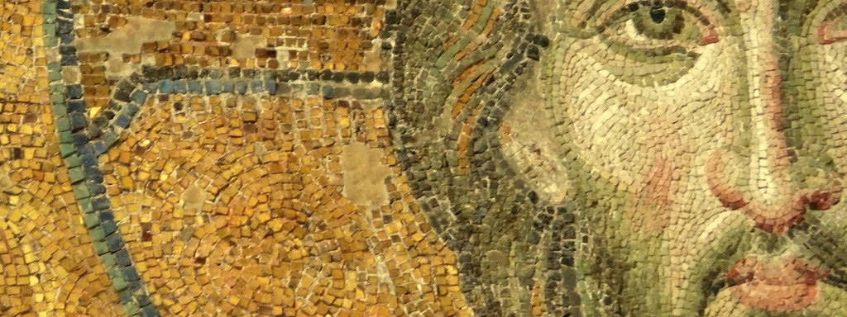
The Fullness of Christ:
Meditations on Our Multidimensional Messiah

Slide 2

1. Introduction:

Slide 3
1. Introduction:

Slide 4
1. Introduction:
Jesus Mosaic (and Art Galleries)

Slide 5
1. Introduction:
Jesus Mosaic (and Art Galleries)
Perspective Matters:

Slide 6
1. Introduction:
Jesus Mosaic (and Art Galleries)
Perspective Matters:
  First we are going to be up close to the individual tiles.

Slide 7
1. Introduction:
Jesus Mosaic (and Art Galleries)
Perspective Matters:
  First we are going to be up close to the individual tiles.
  Second, we are going to pull back and see how this helps us understand Christ in full.

Slide 8
1. Introduction:
Jesus Mosaic (and Art Galleries)
Perspective Matters:
  First we are going to be up close to the individual tiles.
  Second, we are going to pull back and see how this helps us understand Christ in full.
  Third, we are going to try to find a place to hang this mosaic in our everyday lives.

Slide 9
1. Introduction:
Jesus Mosaic (and Art Galleries)
Perspective Matters:
  First we are going to be up close to the individual tiles.
  Second, we are going to pull back and see how this helps us understand Christ in full.
  Third, we are going to try to find a place to hang this mosaic in our everyday lives.
The goal of all this is two-fold:

Slide 10
1. Introduction:
Jesus Mosaic (and Art Galleries)
Perspective Matters:
  First we are going to be up close to the individual tiles.
  Second, we are going to pull back and see how this helps us understand Christ in full.
  Third, we are going to try to find a place to hang this mosaic in our everyday lives.
The goal of all this is two-fold:
  Make much of Christ

Slide 11
1. Introduction:
Jesus Mosaic (and Art Galleries)
Perspective Matters:
  First we are going to be up close to the individual tiles.
  Second, we are going to pull back and see how this helps us understand Christ in full.
  Third, we are going to try to find a place to hang this mosaic in our everyday lives.
The goal of all this is two-fold:
  Make much of Christ
  Let it change us: We want to be more like our messiah

Slide 12

2. Preparing the Way for the Lord?:
Jesus In the Old Testament

Slide 13
2: Jesus in the OT?:
Introduction:

Slide 14
2: Jesus in the OT?:
Introduction:
  Jesus is the messiah and the OT has a lot to say about the messiah, the anointed future ruler over the people of God (Ps 2:2; 18:50; 84:9; 132:10,17)

Slide 15
2: Jesus in the OT?:
Introduction:
  Jesus is the messiah and the OT has a lot to say about the messiah, the anointed future ruler over the people of God (Ps 2:2; 18:50; 84:9; 132:10,17)
Three helps with the OT/NT connections

Slide 16
2: Jesus in the OT?:
Introduction:
  Jesus is the messiah and the OT has a lot to say about the messiah, the anointed future ruler over the people of God (Ps 2:2; 18:50; 84:9; 132:10,17)
Three helps with the OT/NT connections
  Progressive Revelation

Slide 17
2: Jesus in the OT?:
Introduction:
  Jesus is the messiah and the OT has a lot to say about the messiah, the anointed future ruler over the people of God (Ps 2:2; 18:50; 84:9; 132:10,17)
Three helps with the OT/NT connections
  Progressive Revelation
    Bible doesn’t come to us in one final form

Slide 18
2: Jesus in the OT?:
Introduction:
  Jesus is the messiah and the OT has a lot to say about the messiah, the anointed future ruler over the people of God (Ps 2:2; 18:50; 84:9; 132:10,17)
Three helps with the OT/NT connections
  Progressive Revelation
    Bible doesn’t come to us in one final form
    God works in history and enters his history-so too is his written revelation given in history

Slide 19
2: Jesus in the OT?:
Introduction:
  Jesus is the messiah and the OT has a lot to say about the messiah, the anointed future ruler over the people of God (Ps 2:2; 18:50; 84:9; 132:10,17)
Three helps with the OT/NT connections
  Progressive Revelation
  Typology

Slide 20
2: Jesus in the OT?:
Introduction:
  Jesus is the messiah and the OT has a lot to say about the messiah, the anointed future ruler over the people of God (Ps 2:2; 18:50; 84:9; 132:10,17)
Three helps with the OT/NT connections
  Progressive Revelation
  Typology
    What is a type?: persons, groups, institutions and events that foreshadow God’s future redemptive work, often fulfilled in Christ (ex. Adam (type) and Christ (anti-type))

Slide 21
2: Jesus in the OT?:
Introduction:
  Jesus is the messiah and the OT has a lot to say about the messiah, the anointed future ruler over the people of God (Ps 2:2; 18:50; 84:9; 132:10,17)
Three helps with the OT/NT connections
  Progressive Revelation
  Typology
  Promise-Fulfillment Design of Scripture

Slide 22
2: Jesus in the OT?:
Introduction:
  Jesus is the messiah and the OT has a lot to say about the messiah, the anointed future ruler over the people of God (Ps 2:2; 18:50; 84:9; 132:10,17)
Three helps with the OT/NT connections
  Progressive Revelation
  Typology
  Promise-Fulfillment Design of Scripture
    God remains faithful to his promises

Slide 23
2: Jesus in the OT?:
Introduction:
  Jesus is the messiah and the OT has a lot to say about the messiah, the anointed future ruler over the people of God (Ps 2:2; 18:50; 84:9; 132:10,17)
Three helps with the OT/NT connections
  Progressive Revelation
  Typology
  Promise-Fulfillment Design of Scripture
    God remains faithful to his promises
    All God’s Promises Find their Yes in Him (2 Cor 1:20)

Slide 24
2: Jesus in the OT?:
Introduction:
  Jesus is the messiah and the OT has a lot to say about the messiah, the anointed future ruler over the people of God (Ps 2:2; 18:50; 84:9; 132:10,17)
Three helps with the OT/NT connections
  Progressive Revelation
  Typology
  Promise-Fulfillment Design of Scripture
    God remains faithful to his promises
    All God’s Promises Find their Yes in Him (2 Cor 1:20)
    Luke 24:19-27; 44-49 (Beginning with Moses)

Slide 25
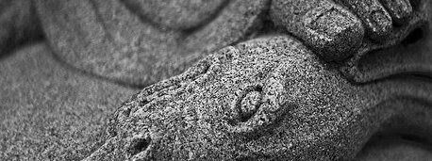
3. Three Messianic Patterns At the Heart of the Old testament

Slide 26
3. Three Messianic Patterns
The Messianic Seed: The Serpent Killer
The Messianic King: The Anointed Son of David
The Messianic Servant: Salvation and Sorrow

Slide 27
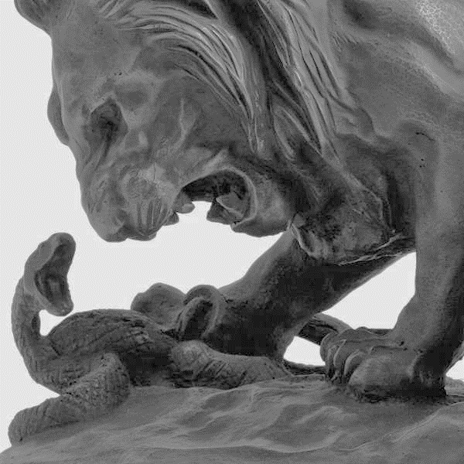

Slide 28
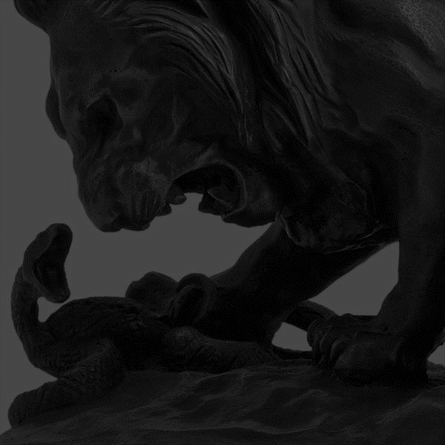
a. The Messianic Seed

Slide 29
a. The Messianic Seed
The Key Text: Genesis 3:15

Slide 30
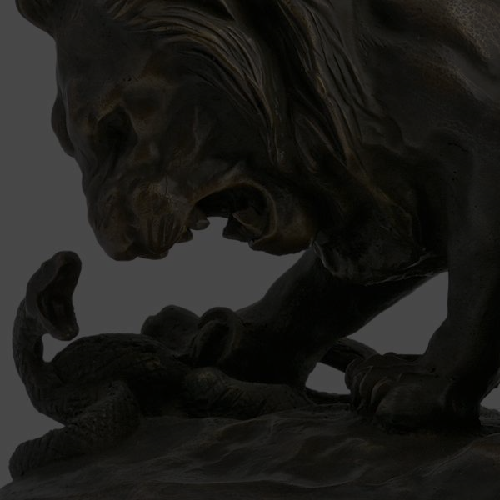
a. The Messianic Seed
The Key Text: Genesis 3:15
  What’s happening in this passage? Judgment and Grace

Slide 31
a. The Messianic Seed
The Key Text: Genesis 3:15
  What’s happening in this passage? Judgment and Grace
  First promise of the Gospel

Slide 32
a. The Messianic Seed
The Key Text: Genesis 3:15
  What’s happening in this passage? Judgment and Grace
  First promise of the Gospel
  Serpent Killer comes from Eve—will be a man

Slide 33
a. The Messianic Seed
The Key Text: Genesis 3:15
  What’s happening in this passage? Judgment and Grace
  First promise of the Gospel
  Serpent Killer comes from Eve—will be a man
  Serpent Killer is a gift from God

Slide 34
a. The Messianic Seed
The Key Text: Genesis 3:15
Seed Through Seth:

Slide 35
a. The Messianic Seed
The Key Text: Genesis 3:15
Seed Through Seth:
  God has granted me another child (literally, seed) in place of Abel, since Cain killed him (Gen 4:25)

Slide 36
a. The Messianic Seed
The Key Text: Genesis 3:15
Seed Through Seth:
  God has granted me another child (literally, seed) in place of Abel, since gain killed him (Gen 4:25)
  Rest of Genesis follows a single line from Seth as the line of promise

Slide 37
a. The Messianic Seed
The Key Text: Genesis 3:15
Seed Through Seth:
  God has granted me another child (literally, seed) in place of Abel, since gain killed him (Gen 4:25)
  Rest of Genesis follows a single line from Seth as the line of promise
  God’s Promise Provided and Protected By God’s Power

Slide 38
a. The Messianic Seed
The Key Text: Genesis 3:15
Seed Through Seth:
  God has granted me another child (literally, seed) in place of Abel, since gain killed him (Gen 4:25)
  Rest of Genesis follows a single line from Seth as the line of promise
  God’s Promise Provided and Protected By God’s Power
  Risk and potential threats to the promise

Slide 39
a. The Messianic Seed
The Key Text: Genesis 3:15
Seed Through Seth:
Expansion of the Seed Promise with Abraham

Slide 40
a. The Messianic Seed
The Key Text: Genesis 3:15
Seed Through Seth:
Expansion of the Seed Promise with Abraham
  God enters into to make his seed thrive in Sarah’s barren womb

Slide 41
a. The Messianic Seed
The Key Text: Genesis 3:15
Seed Through Seth:
Expansion of the Seed Promise with Abraham
  God enters into to make his seed thrive in Sarah’s barren womb
  God promises (Gen 12:2) and covenants (Gen 15) to keep the seed of redemption alive

Slide 42
a. The Messianic Seed
The Key Text: Genesis 3:15
Seed Through Seth:
Expansion of the Seed Promise with Abraham
  God enters into to make his seed thrive in Sarah’s barren womb
  God promises (Gen 12:2) and covenants (Gen 15) to keep the seed of redemption alive
  Expands the promise not only to kill the serpent but to:

Slide 43
a. The Messianic Seed
The Key Text: Genesis 3:15
Seed Through Seth:
Expansion of the Seed Promise with Abraham
  God enters into to make his seed thrive in Sarah’s barren womb
  God promises (Gen 12:2) and covenants (Gen 15) to keep the seed of redemption alive
  Expands the promise not only to kill the serpent but to:
    turn Abraham’s seed into a great nation

Slide 44
a. The Messianic Seed
The Key Text: Genesis 3:15
Seed Through Seth:
Expansion of the Seed Promise with Abraham
  God enters into to make his seed thrive in Sarah’s barren womb
  God promises (Gen 12:2) and covenants (Gen 15) to keep the seed of redemption alive
  Expands the promise not only to kill the serpent but to:
    turn Abraham’s seed into a great nation
    give Abraham’s seed a land

Slide 45
a. The Messianic Seed
The Key Text: Genesis 3:15
Seed Through Seth:
Expansion of the Seed Promise with Abraham
  God enters into to make his seed thrive in Sarah’s barren womb
  God promises (Gen 12:2) and covenants (Gen 15) to keep the seed of redemption alive
  Expands the promise not only to kill the serpent but to:
    turn Abraham’s seed into a great nation
    give Abraham’s seed a land
    bless the nations through Abraham’s seed

Slide 46
a. The Messianic Seed
The Key Text: Genesis 3:15
Seed Through Seth:
Expansion of the Seed Promise with Abraham
  God enters into to make his seed thrive in Sarah’s barren womb
  God promises (Gen 12:2) and covenants (Gen 15) to keep the seed of redemption alive
  Expands the promise not only to kill the serpent but to:
    turn Abraham’s seed into a great nation
    give Abraham’s seed a land
    bless the nations through Abraham’s seed
    be with Abraham and his line forever

Slide 47
a. The Messianic Seed
The Key Text: Genesis 3:15
Seed Through Seth:
Expansion of the Seed Promise with Abraham
Conclusions:

Slide 48
a. The Messianic Seed
The Key Text: Genesis 3:15
Seed Through Seth:
Expansion of the Seed Promise with Abraham
Conclusions:
  Redemption comes for humanity through humanity

Slide 49
a. The Messianic Seed
The Key Text: Genesis 3:15
Seed Through Seth:
Expansion of the Seed Promise with Abraham
Conclusions:
  Redemption comes for humanity through humanity
  But Redemption comes from God, often times through in opposition to man

