Slide 1
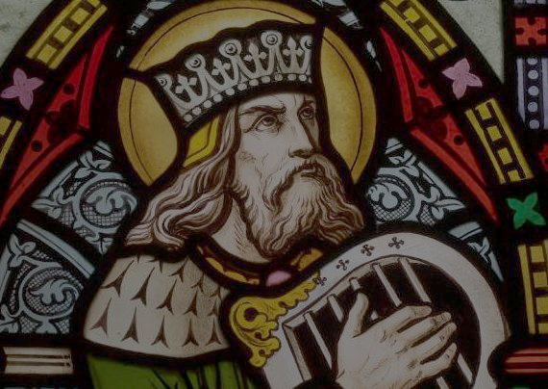

Slide 2
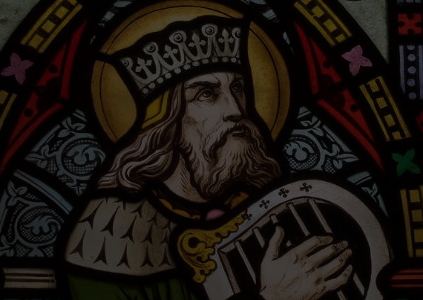
3. The Messianic King
David

Slide 3
3. The Messianic King
David
  Israel’s greatest king

Slide 4
3. The Messianic King
David
  Israel’s greatest king
  Kings that follow David are compared to him

Slide 5
3. The Messianic King
David
  Israel’s greatest king
  Kings that follow David are compared to him
  David is the prototype of the messiah king

Slide 6
3. The Messianic King
David
Key Text: 2 Samuel 7:1-17

Slide 7
3. The Messianic King
David
Key Text: 2 Samuel 7:1-17
  God promises to David a seed that will never leave the throne and will save God’s people

Slide 8
3. The Messianic King
David
Key Text: 2 Samuel 7:1-17
  God promises to David a seed that will never leave the throne and will save God’s people
  The Lord will build a dynasty for David

Slide 9
3. The Messianic King
David
Key Text: 2 Samuel 7:1-17
  God promises to David a seed that will never leave the throne and will save God’s people
  The Lord will build a dynasty for David
  David’s line will rule forever have God’s lovingkindness, and unique father-son relationship

Slide 10
3. The Messianic King
David
Key Text: 2 Samuel 7:1-17
  God promises to David a seed that will never leave the throne and will save God’s people
  The Lord will build a dynasty for David
  David’s line will rule forever have God’s lovingkindness, and unique father-son relationship
  Rest and security for God’s people

Slide 11
3. The Messianic King
David
Key Text: 2 Samuel 7:1-17
  God promises to David a seed that will never leave the throne and will save God’s people
  The Lord will build a dynasty for David
  David’s line will rule forever have God’s lovingkindness, and unique father-son relationship
  Rest and security for God’s people
  Divine Sonship: Ps 2:7 “You are my Son”

Slide 12
3. The Messianic King
David
Key Text: 2 Samuel 7:1-17
Not only is the Messiah a man, he will be king

Slide 13
3. The Messianic King
David
Key Text: 2 Samuel 7:1-17
Not only is the Messiah a man, he will be king:
Not only is the Messiah a king, he will be God’s son

Slide 14
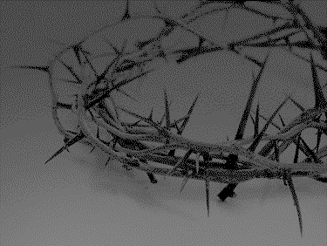

Slide 15
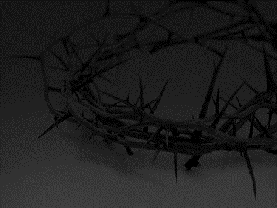
3. The Messianic Servant
Key Text: Isa 52:13-53:12

Slide 16
3. The Messianic Servant
Key Text: Isa 52:13-53:12
A Servant will rise up and bring healing and redemption through his vicarious suffering

Slide 17
3. The Messianic Servant
Key Text: Isa 52:13-53:12
A Servant will rise up and bring healing and redemption through his vicarious suffering
Dies as a substitute for the sins of the people (53:9)

Slide 18
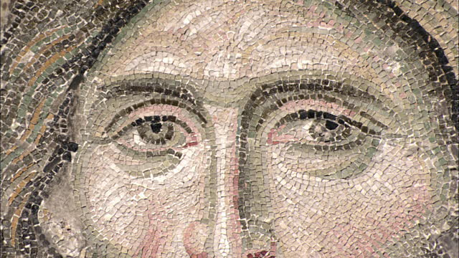
4: Who Do You Say that I am?:
Jesus as the Fulfillment of OT Promises

Slide 19
4. Jesus as the Fulfillment of OT Promises
Jesus as Messianic Seed

Slide 20
4. Jesus as the Fulfillment of OT Promises
Jesus as Messianic Seed
  Jesus is the promised seed (offspring) who destroys the power of the serpent

Slide 21
4. Jesus as the Fulfillment of OT Promises
Jesus as Messianic Seed
  Jesus is the promised seed (offspring) who destroys the power of the serpent
    He is the long awaited seed promised long ago to Eve—come to crush the head of the serpent (resurrection and exaltation) through the bruise on his heel (the crucifixion)

Slide 22

Since therefore the children share in flesh and blood, he himself likewise partook of the same things, that through death he might destroy the one who has the power of death, that is, the devil.
Hebrews 2:14

Slide 23
The reason the Son of God appeared was to destroy the works of the devil.
1 John 3:8

Slide 24
4. Jesus as the Fulfillment of OT Promises
Jesus as Messianic Seed
  Jesus is the promised seed (offspring) who destroys the power of the serpent
    He is the long awaited seed promised long ago to Eve—come to crush the head of the serpent (resurrection and exaltation) through the bruise on his heel (the crucifixion)
  As the seed continues to Abraham, Christ also fulfills the Abrahamic promises

Slide 25
4. Jesus as the Fulfillment of OT Promises
Jesus as Messianic Seed
  Jesus is the promised seed (offspring) who destroys the power of the serpent
    He is the long awaited seed promised long ago to Eve—come to crush the head of the serpent (resurrection and exaltation) through the bruise on his heel (the crucifixion)
  As the seed continues to Abraham, Christ also fulfills the Abrahamic promises
    He is the one who fulfills the promises the Abraham specifically to the Gentiles in Galatia

Slide 26
4. Jesus as the Fulfillment of OT Promises
Jesus as Messianic Seed
  Jesus is the promised seed (offspring) who destroys the power of the serpent
    He is the long awaited seed promised long ago to Eve—come to crush the head of the serpent (resurrection and exaltation) through the bruise on his heel (the crucifixion)
  As the seed continues to Abraham, Christ also fulfills the Abrahamic promises
    He is the one who fulfills the promises the Abraham specifically to the Gentiles in Galatia
    With Christ’s death, resurrection and exaltation God will bring his promises to Adam and Eve as well as Abraham to pass through the seed of Abraham who is Christ (Matt 28:18-20; Rev 5:9-10)

Slide 27
4. Jesus as the Fulfillment of OT Promises
Jesus as Messianic Seed
Jesus as Messianic King

Slide 28
4. Jesus as the Fulfillment of OT Promises
Jesus as Messianic Seed
Jesus as Messianic King
  Matt 1 (cf. Matt 9:27; 15:22; 20:30)

Slide 29
4. Jesus as the Fulfillment of OT Promises
Jesus as Messianic Seed
Jesus as Messianic King
  Matt 1 (cf. Matt 9:27; 15:22; 20:30)
    How our New Testaments start!: David and Abraham’s promises stand fulfilled in the person of Christ (cf. Hosanna to the Son of David (Matt 21:9,15))

Slide 30
4. Jesus as the Fulfillment of OT Promises
Jesus as Messianic Seed
Jesus as Messianic King
  Matt 1 (cf. Matt 9:27; 15:22; 20:30)
    How our New Testaments start!: David and Abraham’s promises stand fulfilled in the person of Christ (cf. Hosanna to the Son of David (Matt 21:9,15))
  Acts 13:22-23

Slide 31
And when he had removed him, he raised up David to be their king, of whom he testified and said, ‘I have found in David the son of Jesse a man after my heart, who will do all my will.’ Of this man's offspring God has brought to Israel a Savior, Jesus, as he promised.
-Acts 13:22-23

Slide 32
4. Jesus as the Fulfillment of OT Promises
Jesus as Messianic Seed
Jesus as Messianic King
  Matt 1 (cf. Matt 9:27; 15:22; 20:30)
    How our New Testaments start!: David and Abraham’s promises stand fulfilled in the person of Christ (cf. Hosanna to the Son of David (Matt 21:9,15))
  Acts 13:22-23
  Rom 1: assumes Christ’s Davidic heritage

Slide 33
Paul, a servant of Christ Jesus, called to be an apostle, set apart for the gospel of God, which he promised beforehand through his prophets in the holy Scriptures, concerning his Son, who was descended from David according to the flesh and was declared to be the Son of God in power according to the Spirit of holiness by his resurrection from the dead…
Romans 1:1-4

Slide 34
4. Jesus as the Fulfillment of OT Promises
Jesus as Messianic Seed
Jesus as Messianic King
  Matt 1 (cf. Matt 9:27; 15:22; 20:30)
    How our New Testaments start!: David and Abraham’s promises stand fulfilled in the person of Christ (cf. Hosanna to the Son of David (Matt 21:9,15))
  Acts 13:22-23
  Rom 1: assumes Christ’s Davidic heritage
  Rev 19:16: King of kings and lord of lords

Slide 35
On his robe and on his thigh he has a name written, King of kings and Lord of lords.
Revelation 19:16

Slide 36
4. Jesus as the Fulfillment of OT Promises
Jesus as Messianic Seed
Jesus as Messianic King
  Matt 1 (cf. Matt 9:27; 15:22; 20:30)
    How our New Testaments start!: David and Abraham’s promises stand fulfilled in the person of Christ (cf. Hosanna to the Son of David (Matt 21:9,15))
  Acts 13:22-23
  Rom 1: assumes Christ’s Davidic heritage
  Rev 19:6: King of kings and lord of lords
  Conclusions: fulfillment of all God’s promises to David:

Slide 37
4. Jesus as the Fulfillment of OT Promises
Jesus as Messianic Seed
Jesus as Messianic King
  Matt 1 (cf. Matt 9:27; 15:22; 20:30)
    How our New Testaments start!: David and Abraham’s promises stand fulfilled in the person of Christ (cf. Hosanna to the Son of David (Matt 21:9,15))
  Acts 13:22-23
  Rom 1: assumes Christ’s Davidic heritage
  Rev 19:6: King of kings and lord of lords
  Conclusions: fulfillment of all God’s promises to David:
      This is the offspring raised up

Slide 38
4. Jesus as the Fulfillment of OT Promises
Jesus as Messianic Seed
Jesus as Messianic King
  Matt 1 (cf. Matt 9:27; 15:22; 20:30)
    How our New Testaments start!: David and Abraham’s promises stand fulfilled in the person of Christ (cf. Hosanna to the Son of David (Matt 21:9,15))
  Acts 13:22-23
  Rom 1: assumes Christ’s Davidic heritage
  Rev 19:6: King of kings and lord of lords
  Conclusions: fulfillment of all God’s promises to David:
      This is the offspring raised up
      He has come to establish the kingdom of God

Slide 39
4. Jesus as the Fulfillment of OT Promises
Jesus as Messianic Seed
Jesus as Messianic King
  Matt 1 (cf. Matt 9:27; 15:22; 20:30)
    How our New Testaments start!: David and Abraham’s promises stand fulfilled in the person of Christ (cf. Hosanna to the Son of David (Matt 21:9,15))
  Acts 13:22-23
  Rom 1: assumes Christ’s Davidic heritage
  Rev 19:6: King of kings and lord of lords
  Conclusions: fulfillment of all God’s promises to David:
      This is the offspring raised up
      He has come to establish the kingdom of God
      The Lord is his father

Slide 40
4. Jesus as the Fulfillment of OT Promises
Jesus as Messianic Seed
Jesus as Messianic King
  Matt 1 (cf. Matt 9:27; 15:22; 20:30)
    How our New Testaments start!: David and Abraham’s promises stand fulfilled in the person of Christ (cf. Hosanna to the Son of David (Matt 21:9,15))
  Acts 13:22-23
  Rom 1: assumes Christ’s Davidic heritage
  Rev 19:6: King of kings and lord of lords
  Conclusions: fulfillment of all God’s promises to David:
      This is the offspring raised up
      He has come to establish the kingdom of God
      The Lord is his father
      He takes the iniquity of man and takes their punishment as well

Slide 41
4. Jesus as the Fulfillment of OT Promises
Jesus as Messianic Seed
Jesus as Messianic King
  Matt 1 (cf. Matt 9:27; 15:22; 20:30)
    How our New Testaments start!: David and Abraham’s promises stand fulfilled in the person of Christ (cf. Hosanna to the Son of David (Matt 21:9,15))
  Acts 13:22-23
  Rom 1: assumes Christ’s Davidic heritage
  Rev 19:6: King of kings and lord of lords
  Conclusions: fulfillment of all God’s promises to David:
      This is the offspring raised up
      He has come to establish the kingdom of God
      The Lord is his father
      He takes the iniquity of man and takes their punishment as well
      He is building a forever house and kingdom

Slide 42
4. Jesus as the Fulfillment of OT Promises
Jesus as Messianic Seed
Jesus as Messianic King
  Matt 1 (cf. Matt 9:27; 15:22; 20:30)
    How our New Testaments start!: David and Abraham’s promises stand fulfilled in the person of Christ (cf. Hosanna to the Son of David (Matt 21:9,15))
  Acts 13:22-23
  Rom 1: assumes Christ’s Davidic heritage
  Rev 19:6: King of kings and lord of lords
  Conclusions: fulfillment of all God’s promises to David:
      This is the offspring raised up
      He has come to establish the kingdom of God
      The Lord is his father
      He takes the iniquity of man and takes their punishment as well
      He is building a forever house and kingdom
      The throne of David is here

Slide 43
4. Jesus as the Fulfillment of OT Promises
Jesus as Messianic Seed
Jesus as Messianic King
Jesus as Messianic Servant: 1 Peter 2:21-25

Slide 44
4. Jesus as the Fulfillment of OT Promises
Jesus as Messianic Seed
Jesus as Messianic King
Jesus as Messianic Servant: 1 Peter 2:21-25
  Christ takes seemingly distinct promises and unites them

Slide 45
4. Jesus as the Fulfillment of OT Promises
Jesus as Messianic Seed
Jesus as Messianic King
Jesus as Messianic Servant: 1 Peter 2:21-25
  Christ takes seemingly distinct promises and unites them
    The human king will wear a crown of thorns

Slide 46
4. Jesus as the Fulfillment of OT Promises
Jesus as Messianic Seed
Jesus as Messianic King
Jesus as Messianic Servant: 1 Peter 2:21-25
  Christ takes seemingly distinct promises and unites them
    The human king will wear a crown of thorns
    His first throne will be a cross

Slide 47
4. Jesus as the Fulfillment of OT Promises
Jesus as Messianic Seed
Jesus as Messianic King
Jesus as Messianic Servant: 1 Peter 2:21-25
  Christ takes seemingly distinct promises and unites them
    The human king will wear a crown of thorns
    His first throne will be a cross
  NT interprets the suffering servant as Jesus—Mark 10:45

Slide 48
For even the Son of Man came not to be served but to serve, and to give his life as a ransom for many.”
Mark 10:45

Slide 49
4. Jesus as the Fulfillment of OT Promises
Jesus as Messianic Seed
Jesus as Messianic King
Jesus as Messianic Servant: 1 Peter 2:21-25
  Christ takes seemingly distinct promises and unites them
    The human king will wear a crown of thorns
    His first throne will be a cross
  NT interprets the suffering servant as Jesus—Mark 10:45
  Matthew 8:17: He takes our weaknesses and carried our diseases (cf. Isa 53:4)

Slide 50
This was to fulfill what was spoken by the prophet Isaiah: “He took our illnesses and bore our diseases.”
Matthew 8:17

Slide 51
4. Jesus as the Fulfillment of OT Promises
Jesus as Messianic Seed
Jesus as Messianic King
Jesus as Messianic Servant: 1 Peter 2:21-25
  Christ takes seemingly distinct promises and unites them
    The human king will wear a crown of thorns
    His first throne will be a cross
  NT interprets the suffering servant as Jesus—Mark 10:45
  Matthew 8:17: He takes our weaknesses and carried our diseases (cf. Isa 53:4)
  John 1:29: Behold the Lamb of God (the lamb led to the slaughter (cf. Isa 53:7))

Slide 52
The next day he saw Jesus coming toward him, and said, “Behold, the Lamb of God, who takes away the sin of the world!
John 1:29

Slide 53
4. Jesus as the Fulfillment of OT Promises
Jesus as Messianic Seed
Jesus as Messianic King
Jesus as Messianic Servant: 1 Peter 2:21-25
  Christ takes seemingly distinct promises and unites them
    The human king will wear a crown of thorns
    His first throne will be a cross
  NT interprets the suffering servant as Jesus—Mark 10:45
  Matthew 8:17: He takes our weaknesses and carried our diseases (cf. Isa 53:4)
  John 1:29: Behold the Lamb of God (the lamb led to the slaughter (cf. Isa 53:7))
  1 Peter 2:

Slide 54
For to this you have been called, because Christ also suffered for you, leaving you an example, so that you might follow in his steps. He committed no sin, neither was deceit found in his mouth. When he was reviled, he did not revile in return; when he suffered, he did not threaten, but continued entrusting himself to him who judges justly. He himself bore our sins in his body on the tree, that we might die to sin and live to righteousness. By his wounds you have been healed. For you were straying like sheep, but have now returned to the Shepherd and Overseer of your souls.
1 Peter 2:21-25

Slide 55
4. Jesus as the Fulfillment of OT Promises
Jesus as Messianic Seed
Jesus as Messianic King
Jesus as Messianic Servant: 1 Peter 2:21-25
  Christ takes seemingly distinct promises and unites them
    The human king will wear a crown of thorns
    His first throne will be a cross
  NT interprets the suffering servant as Jesus—Mark 10:45
  Matthew 8:17: He takes our weaknesses and carried our diseases (cf. Isa 53:4)
  John 1:29: Behold the Lamb of God (the lamb led to the slaughter (cf. Isa 53:7))
  1 Peter 2:
    Christ is the model for the suffering church

Slide 56
4. Jesus as the Fulfillment of OT Promises
Jesus as Messianic Seed
Jesus as Messianic King
Jesus as Messianic Servant: 1 Peter 2:21-25
  Christ takes seemingly distinct promises and unites them
    The human king will wear a crown of thorns
    His first throne will be a cross
  NT interprets the suffering servant as Jesus—Mark 10:45
  Matthew 8:17: He takes our weaknesses and carried our diseases (cf. Isa 53:4)
  John 1:29: Behold the Lamb of God (the lamb led to the slaughter (cf. Isa 53:7))
  1 Peter 2:
    Christ is the model for the suffering church
    Christ suffers on our behalf –for his blood makes a way for salvation

Slide 57
4. Jesus as the Fulfillment of OT Promises
Jesus as Messianic Seed
Jesus as Messianic King
Jesus as Messianic Servant: 1 Peter 2:21-25
  Christ takes seemingly distinct promises and unites them
    The human king will wear a crown of thorns
    His first throne will be a cross
  NT interprets the suffering servant as Jesus—Mark 10:45
  Matthew 8:17: He takes our weaknesses and carried our diseases (cf. Isa 53:4)
  John 1:29: Behold the Lamb of God (the lamb led to the slaughter (cf. Isa 53:7))
  1 Peter 2:
    Christ is the model for the suffering church
    Christ suffers on our behalf –for his blood makes a way for salvation
    He is sinless (2:22) and yet takes the sins of the people as their substitute

Slide 58
4. Jesus as the Fulfillment of OT Promises
Jesus as Messianic Seed
Jesus as Messianic King
Jesus as Messianic Servant: 1 Peter 2:21-25
  Christ takes seemingly distinct promises and unites them
    The human king will wear a crown of thorns
    His first throne will be a cross
  NT interprets the suffering servant as Jesus—Mark 10:45
  Matthew 8:17: He takes our weaknesses and carried our diseases (cf. Isa 53:4)
  John 1:29: Behold the Lamb of God (the lamb led to the slaughter (cf. Isa 53:7))
  1 Peter 2:
    Christ is the model for the suffering church
    Christ suffers on our behalf –for his blood makes a way for salvation
    He is sinless (2:22) and yet takes the sins of the people as their substitute
    Jesus does not retaliate—he is the silent lamb in this midst of his murderers

Slide 59
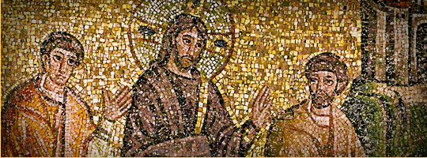
5. Conclusion:
How Does Our Meditation Change Us Today?

Slide 60
5. Conclusion: Transformation?

Slide 61
5. Conclusion: Transformation?
Why does it matter that Jesus is the Messianic Seed?

Slide 62
5. Conclusion: Transformation?
Why does it matter that Jesus is the Messianic Seed?
Why does it matter that Jesus is the Messianic King?

Slide 63
5. Conclusion: Transformation?
Why does it matter that Jesus is the Messianic Seed?
Why does it matter that Jesus is the Messianic King?
Why does it matter that Jesus is the Messianic Servant?

