Slide 1
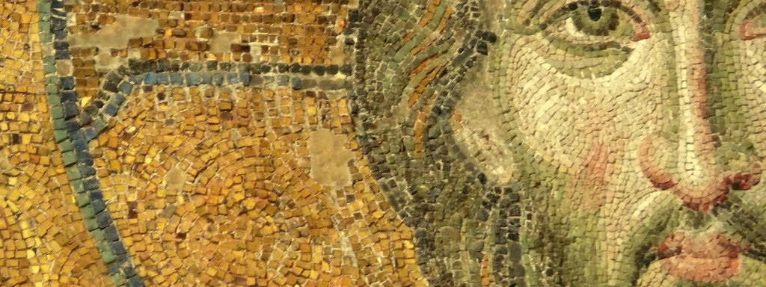
The Fullness of Christ:
Meditations on Our Multidimensional Messiah

Slide 2
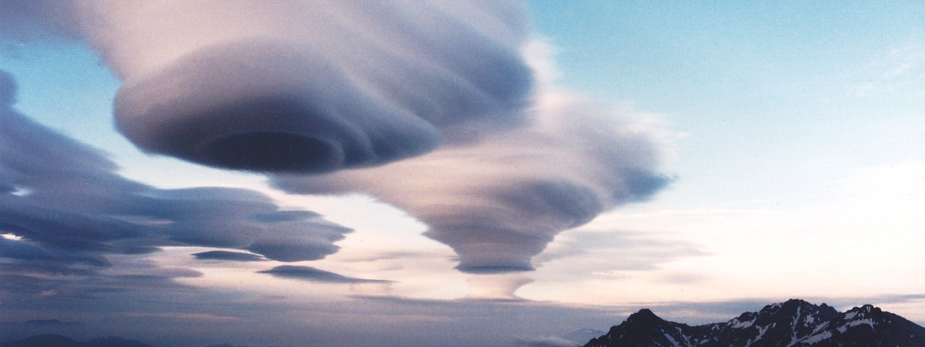
Lesson Two: The Son of Man

Slide 3
When You hear the Title, “The Son of Man,” What do you Think of?:

Slide 4
1. Introduction:
When you hear the title “Son of Man” what do you think of?
  Generally most think this title concerns Jesus’ humanity due to the use of the term “man”

Slide 5
1. Introduction:
When you hear the title “Son of Man” what do you think of?
  Generally most think this title concerns Jesus’ humanity due to the use of the term “man”
  But, when we evaluate this designation from a full biblical perspective we see that it includes more than just humanity—it is a messianic description

Slide 6
1. Introduction:
When you hear the title “Son of Man” what do you think of?
  Generally most think this title concerns Jesus’ humanity due to the use of the term “man”
  But, when we evaluate this designation from a full biblical perspective we see that it includes more than just humanity—it is a messianic description
  The title, “Son of Man,” describes a human with full divine authority who has received an eternal kingdom from God to rule and reign (Messiah: anointed future ruler over the people of God)

Slide 7
1. Introduction:
When you hear the title “Son of Man” what do you think of?
  Generally most think this title concerns Jesus’ humanity due to the use of the term “man”
  But, when we evaluate this designation from a full biblical perspective we see that it includes more than just humanity—it is a messianic description
  The title, “Son of Man,” describes a human with full divine authority who has received an eternal kingdom from God to rule and reign (Messiah: anointed future ruler over the people of God)
Why is this title important?

Slide 8
1. Introduction:
When you hear the title “Son of Man” what do you think of?
  Generally most think this title concerns Jesus’ humanity due to the use of the term “man”
  But, when we evaluate this designation from a full biblical perspective we see that it includes more than just humanity—it is a messianic description
  The title, “Son of Man,” describes a human with full divine authority who has received an eternal kingdom from God to rule and reign (Messiah: anointed future ruler over the people of God)
Why is this title important?
  The term “Son of Man” is used most frequently in reference to Jesus (other than “Jesus”) in the Gospels

Slide 9
1. Introduction:
When you hear the title “Son of Man” what do you think of?
  Generally most think this title concerns Jesus’ humanity due to the use of the term “man”
  But, when we evaluate this designation from a full biblical perspective we see that it includes more than just humanity—it is a messianic description
  The title, “Son of Man,” describes a human with full divine authority who has received an eternal kingdom from God to rule and reign (Messiah: anointed future ruler over the people of God)
Why is this title important?
  The term “Son of Man” is used most frequently in reference to Jesus (other than “Jesus”) in the Gospels
  The title is used 82 times in the Matthew, Mark, Luke, and John

Slide 10
1. Introduction:
When you hear the title “Son of Man” what do you think of?
  Generally most think this title concerns Jesus’ humanity due to the use of the term “man”
  But, when we evaluate this designation from a full biblical perspective we see that it includes more than just humanity—it is a messianic description
  The title, “Son of Man,” describes a human with full divine authority who has received an eternal kingdom from God to rule and reign (Messiah: anointed future ruler over the people of God)
Why is this title important?
  The term “Son of Man” is used most frequently in reference to Jesus (other than “Jesus”) in the Gospels
  The title is used 82 times in the Matthew, Mark, Luke, and John
  Finally, it is Jesus’ favorite self-designation

Slide 11
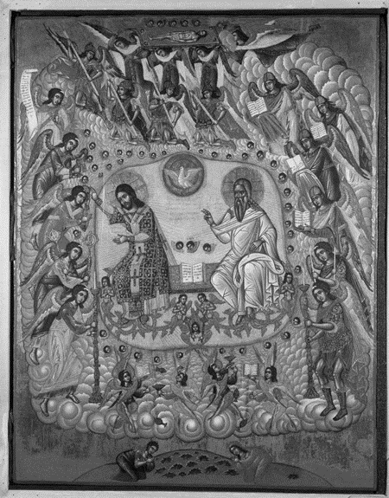
ii. Where Does Jesus Get the
“Son of Man” Title?

Slide 12
ii. Where does Jesus Get This Title?
Daniel 7:13-14 is critical to understand what Son of Man means

Slide 13

“I saw in the night visions, and behold, with the clouds of heaven there came one like a son of man, and he came to the Ancient of Days and was presented before him. And to him was given dominion and glory and a kingdom, that all peoples, nations, and languages should serve him; his dominion is an everlasting dominion, which shall not pass away, and his kingdom one that shall not be destroyed.”
Daniel 7:13-14 ESV

Slide 14
ii. Where does Jesus Get This Title?
Daniel 7:13-14 is critical to understand what Son of Man means
Evaluation of Daniel 7:13-14:

Slide 15
ii. Where does Jesus Get This Title?
Daniel 7:13-14 is critical to understand what Son of Man means
Evaluation of Daniel 7:13-14:
  Introduction:

Slide 16
ii. Where does Jesus Get This Title?
Daniel 7:13-14 is critical to understand what Son of Man means
Evaluation of Daniel 7:13-14:
  Introduction:
    “One like a son of man” is a description, not a title

Slide 17
ii. Where does Jesus Get This Title?
Daniel 7:13-14 is critical to understand what Son of Man means
Evaluation of Daniel 7:13-14:
  Introduction:
    “One like a son of man” is a description, not a title
    It describes one who receives kingdom authority from the Ancient of Days, the God of heaven

Slide 18
ii. Where does Jesus Get This Title?
Daniel 7:13-14 is critical to understand what Son of Man means
Evaluation of Daniel 7:13-14:
  Introduction:
  Description One: Who the son of man is

Slide 19
ii. Where does Jesus Get This Title?
Daniel 7:13-14 is critical to understand what Son of Man means
Evaluation of Daniel 7:13-14:
  Introduction:
  Description One: Who the son of man is
    Humanity Focus:

Slide 20
ii. Where does Jesus Get This Title?
Daniel 7:13-14 is critical to understand what Son of Man means
Evaluation of Daniel 7:13-14:
  Introduction:
  Description One: Who the son of man is
    Humanity Focus:
      The term, with its emphasis on “man,” is obviously a description of a human being

Slide 21
ii. Where does Jesus Get This Title?
Daniel 7:13-14 is critical to understand what Son of Man means
Evaluation of Daniel 7:13-14:
  Introduction:
  Description One: Who the son of man is
    Humanity Focus:
      The term, with its emphasis on “man,” is obviously a description of a human being
    Deity Focus:

Slide 22
ii. Where does Jesus Get This Title?
Daniel 7:13-14 is critical to understand what Son of Man means
Evaluation of Daniel 7:13-14:
  Introduction:
  Description One: Who the son of man is
    Humanity Focus:
      The term, with its emphasis on “man,” is obviously a description of a human being
    Deity Focus:
      But this human being is also different than other humans

Slide 23
ii. Where does Jesus Get This Title?
Daniel 7:13-14 is critical to understand what Son of Man means
Evaluation of Daniel 7:13-14:
  Introduction:
  Description One: Who the son of man is
    Humanity Focus:
      The term, with its emphasis on “man,” is obviously a description of a human being
    Deity Focus:
      But this human being is also different than other humans
      He is the one “coming/’riding’ on the clouds” a description typically saved for deity in the OT (Exod 14:20; 34:5; Num 10:34; Ps 104:3; Isa 19:1)

Slide 24
The LORD descended in the cloud and stood with him there, and proclaimed the name of the LORD.
(Exodus 34:5 ESV)

Slide 25
ii. Where does Jesus Get This Title?
Daniel 7:13-14 is critical to understand what Son of Man means
Evaluation of Daniel 7:13-14:
  Introduction:
  Description One: Who the son of man is
    Humanity Focus:
      The term, with its emphasis on “man,” is obviously a description of a human being
    Deity Focus:
      But this human being is also different than other humans
      He is the one “coming/’riding’ on the clouds” a description typically saved for deity in the OT (Exod 14:20; 34:5; Num 10:34; Ps 104:3; Isa 19:1)
      The “one like the son of man” can stand before the Ancient of Days, a designation for God—only the holy and righteous can stand before God

Slide 26
ii. Where does Jesus Get This Title?
Daniel 7:13-14 is critical to understand what Son of Man means
Evaluation of Daniel 7:13-14:
  Introduction:
  Description One: Who the son of man is
  Description Two: What the son of man receives:

Slide 27
ii. Where does Jesus Get This Title?
Daniel 7:13-14 is critical to understand what Son of Man means
Evaluation of Daniel 7:13-14:
  Introduction:
  Description One: Who the son of man is
  Description Two: What the son of man receives:
    Dominion, Glory, Kingdom: All divinely given (only God can give) and only for God (only God can receive)

Slide 28
ii. Where does Jesus Get This Title?
Daniel 7:13-14 is critical to understand what Son of Man means
Evaluation of Daniel 7:13-14:
  Introduction:
  Description One: Who the son of man is
  Description Two: What the son of man receives:
    Dominion, Glory, Kingdom: All divinely given (only God can give) and only for God (only God can receive)
      These are all eternal: it is an everlasting dominion, a kingdom that will not be destroyed

Slide 29
ii. Where does Jesus Get This Title?
Daniel 7:13-14 is critical to understand what Son of Man means
Evaluation of Daniel 7:13-14:
  Introduction:
  Description One: Who the son of man is
  Description Two: What the son of man receives:
    Dominion, Glory, Kingdom: All divinely given (only God can give) and only for God (only God can receive)
      These are all eternal: it is an everlasting dominion, a kingdom that will not be destroyed
    Service: The one like the son of man will be served by all people, nations, and languages

Slide 30
ii. Where does Jesus Get This Title?
Daniel 7:13-14 is critical to understand what Son of Man means
Evaluation of Daniel 7:13-14:
  Introduction:
  Description One: Who the son of man is
  Description Two: What the son of man receives:
  Conclusion:
    The OT book of Daniel prepares us for a man, invested with divine authority, who will rule and reign over an everlasting kingdom.

Slide 31
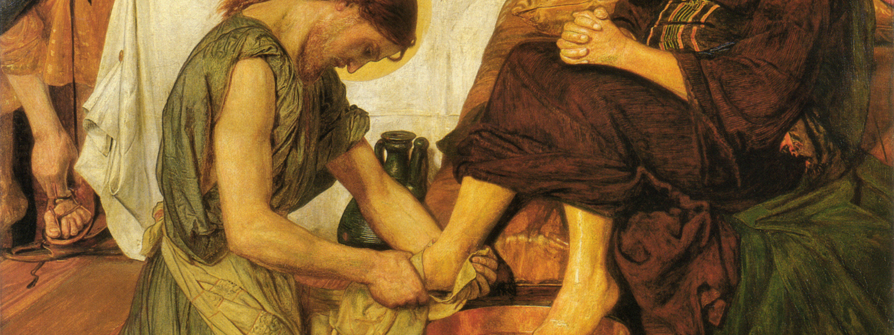
iii. How Does Jesus Use the Title,
“The Son of Man”?

Slide 32
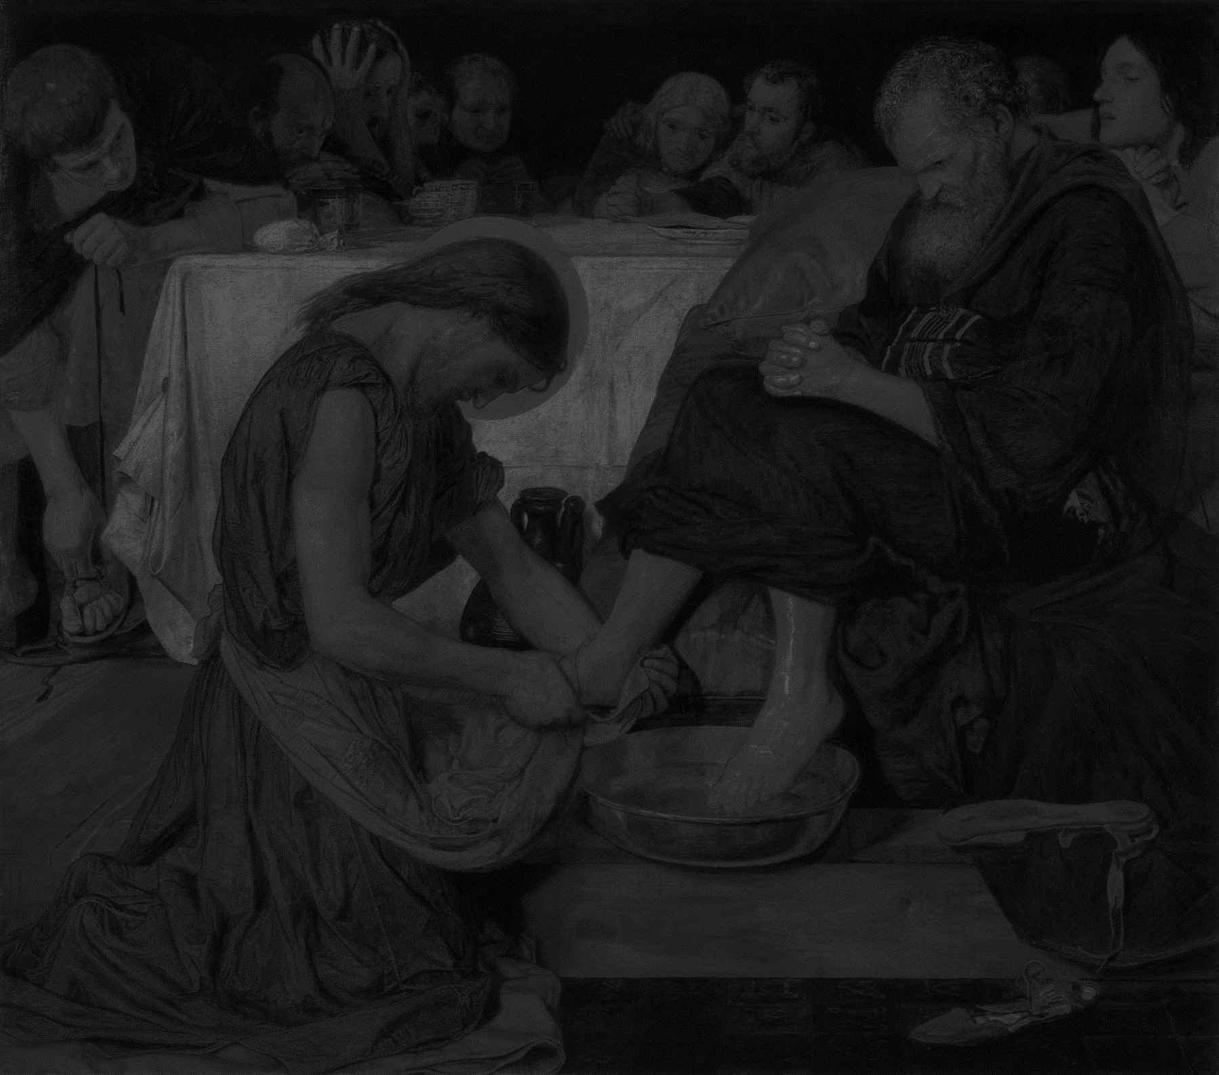
iii. How Does Jesus Use This Title?
Introduction: Jesus uses the ambiguity of this OT designation, “one like a son of man,” to fill it with the content of his ministry

Slide 33
iii. How Does Jesus Use This Title?
Introduction: Jesus uses the ambiguity of this OT designation, “one like a son of man,” to fill it with the content of his ministry
To describe his earthly ministry
  The Son of Man has the authority to forgive sins (Mark 2:10)

Slide 34
But that you may know that the Son of Man has authority on earth to forgive sins”
(Mark 2:10 ESV)

Slide 35
iii. How Does Jesus Use This Title?
Introduction: Jesus uses the ambiguity of this OT designation, “one like a son of man,” to fill it with the content of his ministry
To describe his earthly ministry
  The Son of Man has the authority to forgive sins (Mark 2:10)
  The Son of Man is the Lord of the Sabbath (Mark 2:27)

Slide 36
And he said to them, “The Sabbath was made for man, not man for the Sabbath. So the Son of Man is lord even of the Sabbath.”
(Mark 2:27-28 ESV)
Notes:
Jesus next (see note on vv. 25–26) emphasizes that man is not to be confined by the Sabbath but rather that the Sabbath is given as a gift to man (for spiritual and physical refreshment). Again Jesus emphasizes his authority as Son of Man (see Introduction: Key Themes; and note on Matt. 8:20). If the Sabbath is for the benefit of mankind, and if the Son of Man is Lord over all mankind, then the Son of Man is surely lord even of the Sabbath.

Slide 37
iii. How Does Jesus Use This Title?
Introduction: Jesus uses the ambiguity of this OT designation, “one like a son of man,” to fill it with the content of his ministry
To describe his earthly ministry
  The Son of Man has the authority to forgive sins (Mark 2:10)
  The Son of Man is the Lord of the Sabbath (Mark 2:27)
  The Son of Man has nowhere to lay his head (Matt 8:20)

Slide 38
And Jesus said to him, “Foxes have holes, and birds of the air have nests, but the Son of Man has nowhere to lay his head.”(Matthew 8:20 ESV)

Slide 39
iii. How Does Jesus Use This Title?
Introduction: Jesus uses the ambiguity of this OT designation, “one like a son of man,” to fill it with the content of his ministry
To describe his earthly ministry
  The Son of Man has the authority to forgive sins (Mark 2:10)
  The Son of Man is the Lord of the Sabbath (Mark 2:27)
  The Son of Man has nowhere to lay his head (Matt 8:20)
  The Son of Man sows good seed (Matt 13:37)

Slide 40
He answered, “The one who sows the good seed is the Son of Man. (Matthew 13:37 ESV)

Slide 41
iii. How Does Jesus Use This Title?
Introduction: Jesus uses the ambiguity of this OT designation, “one like a son of man,” to fill it with the content of his ministry
To describe his earthly ministry
  The Son of Man has the authority to forgive sins (Mark 2:10)
  The Son of Man is the Lord of the Sabbath (Mark 2:27)
  The Son of Man has nowhere to lay his head (Matt 8:20)
  The Son of Man sows good seed (Matt 13:37)
  The Son of Man’s presence leads to persecution (Luke 6:22)

Slide 42
“Blessed are you when people hate you and when they exclude you and revile you and spurn your name as evil, on account of the Son of Man! (Luke 6:22 ESV)

Slide 43
iii. How Does Jesus Use This Title?
Introduction: Jesus uses the ambiguity of this OT designation, “one like a son of man,” to fill it with the content of his ministry
To describe his earthly ministry
  The Son of Man has the authority to forgive sins (Mark 2:10)
  The Son of Man is the Lord of the Sabbath (Mark 2:27)
  The Son of Man has nowhere to lay his head (Matt 8:20)
  The Son of Man sows good seed (Matt 13:37)
  The Son of Man’s presence leads to persecution (Luke 6:22)
  The Son of Man comes to seek and save the lost (Luke 19:10)

Slide 44
For the Son of Man came to seek and to save the
lost.”
(Luke 19:10 ESV)

Slide 45
iii. How Does Jesus Use This Title?
Introduction: Jesus uses the ambiguity of this OT designation, “one like a son of man,” to fill it with the content of his ministry
To describe his earthly ministry
To describe his suffering:

Slide 46
iii. How Does Jesus Use This Title?
Introduction: Jesus uses the ambiguity of this OT designation, “one like a son of man,” to fill it with the content of his ministry
To describe his earthly ministry
To describe his suffering:
  The Son of Man will suffer (Mark 8:31)

Slide 47
And he began to teach them that the Son of Man must suffer many things and be rejected by the elders and the chief priests and the scribes and be killed, and after three days rise again.
(Mark 8:31 ESV)

Slide 48
iii. How Does Jesus Use This Title?
Introduction: Jesus uses the ambiguity of this OT designation, “one like a son of man,” to fill it with the content of his ministry
To describe his earthly ministry
To describe his suffering:
  The Son of Man will suffer (Mark 8:31)
  The Son of Man will be delivered and condemned (Mark 10:33; 14:41)

Slide 49
And he came the third time and said to them, “Are you still sleeping and taking your rest? It is enough; the hour has come. The Son of Man is betrayed into the hands of sinners.
(Mark 14:41 ESV)

Slide 50
iii. How Does Jesus Use This Title?
Introduction: Jesus uses the ambiguity of this OT designation, “one like a son of man,” to fill it with the content of his ministry
To describe his earthly ministry
To describe his suffering:
  The Son of Man will suffer (Mark 8:31)
  The Son of Man will be delivered and condemned (Mark 10:33; 14:41)
  The Son of Man came to serve and give his life as a ransom for many (Mark 10:45; Matt 20:28; cf. Suffering Servant in Isaiah 52-53)

Slide 51
For even the Son of Man came not to be served but to serve, and to give his life as a ransom for many.”
(Mark 10:45 ESV)

Slide 52
iii. How Does Jesus Use This Title?
Introduction: Jesus uses the ambiguity of this OT designation, “one like a son of man,” to fill it with the content of his ministry
To describe his earthly ministry
To describe his suffering:
To describe his coming apocalyptic work:
  The Son of Man comes at an unknown time (Luke 12:40; Matt 24:27), suddenly and catastrophically (Luke 17:26; Matt 24:37)

Slide 53
For as the lightning comes from the east and shines as far as the west, so will be the coming of the Son of Man.(Matthew 24:27 ESV)

Slide 54
iii. How Does Jesus Use This Title?
Introduction: Jesus uses the ambiguity of this OT designation, “one like a son of man,” to fill it with the content of his ministry
To describe his earthly ministry
To describe his suffering:
To describe his coming apocalyptic work:
  The Son of Man comes at an unknown time (Luke 12:40; Matt 24:27), suddenly and catastrophically (Luke 17:26; Matt 24:37)
  The Son of Man comes with angels (Matt 13:41)

Slide 55
The Son of Man will send his angels, and they will gather out of his kingdom all causes of sin and all law-breakers, and throw them into the fiery furnace. In that place there will be weeping and gnashing of teeth. Then the righteous will shine like the sun in the kingdom of their Father. He who has ears, let him hear. (Matthew 13:41-43 ESV)

Slide 56
iii. How Does Jesus Use This Title?
Introduction: Jesus uses the ambiguity of this OT designation, “one like a son of man,” to fill it with the content of his ministry
To describe his earthly ministry
To describe his suffering:
To describe his coming apocalyptic work:
  The Son of Man comes at an unknown time (Luke 12:40; Matt 24:27), suddenly and catastrophically (Luke 17:26; Matt 24:37)
  The Son of Man comes with angels (Matt 13:41)
  The Son of Man comes with the heavens shaking (Matt 24:30)

Slide 57
Then will appear in heaven the sign of the Son of Man, and then all the tribes of the earth will mourn, and they will see the Son of Man coming on the clouds of heaven with power and great glory. (Matthew 24:30 ESV)

Slide 58
iii. How Does Jesus Use This Title?
Introduction: Jesus uses the ambiguity of this OT designation, “one like a son of man,” to fill it with the content of his ministry
To describe his earthly ministry
To describe his suffering:
To describe his coming apocalyptic work:
  The Son of Man comes at an unknown time (Luke 12:40; Matt 24:27), suddenly and catastrophically (Luke 17:26; Matt 24:37)
  The Son of Man comes with angels (Matt 13:41)
  The Son of Man comes with the heavens shaking (Matt 24:30)
  The Son of Man comes in glory (Matt 25:31)

Slide 59
“When the Son of Man comes in his glory, and all the angels with him, then he will sit on his glorious throne.
(Matthew 25:31 ESV)

Slide 60
iii. How Does Jesus Use This Title?
Introduction: Jesus uses the ambiguity of this OT designation, “one like a son of man,” to fill it with the content of his ministry
To describe his earthly ministry
To describe his suffering:
To describe his coming apocalyptic work:
  The Son of Man comes at an unknown time (Luke 12:40; Matt 24:27), suddenly and catastrophically (Luke 17:26; Matt 24:37)
  The Son of Man comes with angels (Matt 13:41)
  The Son of Man comes with the heavens shaking (Matt 24:30)
  The Son of Man comes in glory (Matt 25:31)
  The Son of Man will recognize, before the angels, those who believe in him (Luke 12:8)

Slide 61
“And I tell you, everyone who acknowledges me before men, the Son of Man also will acknowledge before the angels of God,
(Luke 12:8 ESV)

Slide 62
iii. How Does Jesus Use This Title?
Introduction: Jesus uses the ambiguity of this OT designation, “one like a son of man,” to fill it with the content of his ministry
To describe his earthly ministry
To describe his suffering:
To describe his coming apocalyptic work:
  The Son of Man comes at an unknown time (Luke 12:40; Matt 24:27), suddenly and catastrophically (Luke 17:26; Matt 24:37)
  The Son of Man comes with angels (Matt 13:41)
  The Son of Man comes with the heavens shaking (Matt 24:30)
  The Son of Man comes in glory (Matt 25:31)
  The Son of Man will recognize before the angels those who believe in him (Luke 12:8)
  The Son of Man is the one the disciples will stand before in their faithfulness (Luke 21:36)

Slide 63
But stay awake at all times, praying that you may have strength to escape all these things that are going to take place, and to stand before the Son of Man.”(Luke 21:36 ESV)

Slide 64
iii. How Does Jesus Use This Title?
Introduction: Jesus uses the ambiguity of this OT designation, “one like a son of man,” to fill it with the content of his ministry
To describe his earthly ministry
To describe his suffering:
To describe his coming apocalyptic work:
  The Son of Man comes at an unknown time (Luke 12:40; Matt 24:27), suddenly and catastrophically (Luke 17:26; Matt 24:37)
  The Son of Man comes with angels (Matt 13:41)
  The Son of Man comes with the heavens shaking (Matt 24:30)
  The Son of Man comes in glory (Matt 25:31)
  The Son of Man will recognize before the angels those who believe in him (Luke 12:8)
  The Son of Man is the one the disciples will stand before in their faithfulness (Luke 21:36)
  The Son of Man has authority to judge (John 5:27)

Slide 65
And he has given him authority to execute judgment, because he is the Son of Man.
(John 5:27 ESV)

Slide 66
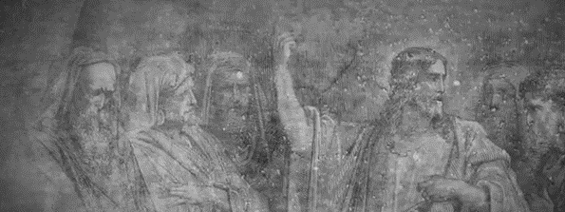
iv. What Does the Title, “The Son of Man,” Tell Us About Jesus?

Slide 67
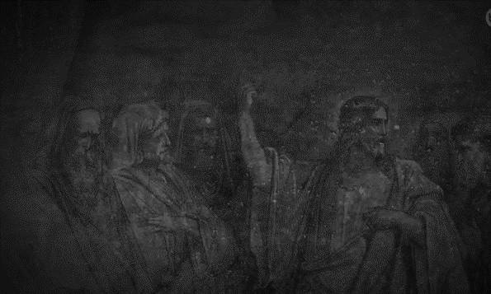
iV. What Does This Title Tell Us?
Introduction:
  This question is central to the gospel:

Slide 68
iV. What Does This Title Tell Us?
Introduction:
  This question is central to the gospel:
    When Jesus came to the region of Caesarea Philippi, he asked his disciples

Slide 69
“Who do people say that the Son of Man is?”
(Matthew 16:13 ESV)

Slide 70
iV. What Does This Title Tell Us?
Introduction:
  This question is central to the gospel:
    When Jesus came to the region of Caesarea Philippi, he asked his disciples, “Who do people say the Son of Man is?” (Matt 16:13)
    The answer: The Son of Man is the Christ, the Messiah

Slide 71
Simon Peter replied, “You are the Christ, the Son of the living God.” And Jesus answered him, “Blessed are you, Simon Bar-Jonah! For flesh and blood has not revealed this to you, but my Father who is in heaven.
(Matthew 16:16-17 ESV)

Slide 72
iV. What Does This Title Tell Us?
Introduction:
  This question is central to the gospel:
    When Jesus came to the region of Caesarea Philippi, he asked his disciples, “Who do people say the Son of Man is?” (Matt 16:13)
    The answer: The Son of Man is the Christ, the Messiah
  Jesus uses the breadth of the OT designation, “one like a son of man,” to fill it with messianic content—categories rooted in the OT’s original description

Slide 73
iV. What Does This Title Tell Us?
Introduction:
  This question is central to the gospel:
    When Jesus came to the region of Caesarea Philippi, he asked his disciples, “Who do people say the Son of Man is?” (Matt 16:13)
    The answer: The Son of Man is the Christ, the Messiah
  Jesus uses the breadth of the OT designation, “one like a son of man,” to fill it with messianic content—categories rooted in the OT’s original description
  Jesus shows that the title corresponds with the major movements of Jesus’ life and the reality of the gospel:

Slide 74
iV. What Does This Title Tell Us?
Introduction:
  This question is central to the gospel:
    When Jesus came to the region of Caesarea Philippi, he asked his disciples, “Who do people say the Son of Man is?” (Matt 16:13)
    The answer: The Son of Man is the Christ, the Messiah
  Jesus uses the breadth of the OT designation, “one like a son of man,” to fill it with messianic content—categories rooted in the OT’s original description
  Jesus shows that the title corresponds with the major movements of Jesus’ life and the reality of the gospel:
    The Son of Man concerns the Messiah’s earthly teaching, death and resurrection, and future return

Slide 75
iV. What Does This Title Tell Us?
Introduction:
  This question is central to the gospel:
    When Jesus came to the region of Caesarea Philippi, he asked his disciples, “Who do people say the Son of Man is?” (Matt 16:13)
    The answer: The Son of Man is the Christ, the Messiah
  Jesus uses the breadth of the OT designation, “one like a son of man,” to fill it with messianic content—categories rooted in the OT’s original description
  Jesus shows that the title corresponds with the major movements of Jesus’ life and the reality of the gospel:
    The Son of Man concerns the Messiah’s earthly teaching, death and resurrection, and future return
    This the Son of Man designation is tied to “the gospel explained,” “the gospel inaugurated,” and “the gospel consummated”

Slide 76
iV. What Does This Title Tell Us?
Introduction:
  This question is central to the gospel:
    When Jesus came to the region of Caesarea Philippi, he asked his disciples, “Who do people say the Son of Man is?” (Matt 16:13)
    The answer: The Son of Man is the Christ, the Messiah
  Jesus uses the breadth of the OT designation, “one like a son of man,” to fill it with messianic content—categories rooted in the OT’s original description
  Jesus shows that the title corresponds with the major movements of Jesus’ life and the reality of the gospel:
    The Son of Man concerns the Messiah’s earthly teaching, death and resurrection, and future return
    This the Son of Man designation is tied to “the gospel explained,” “the gospel inaugurated,” and “the gospel consummated”
  The fulfillment of the Messianic Seed, Messianic Servant, and Messianic King are each on display in Christ as the Son of Man

Slide 77
iV. What Does This Title Tell Us?
Introduction:
Messianic Seed: The Son of Man is Human, doing earthly ministry among other humans

Slide 78
2. Messianic Seed: earthly Ministry
Biblical Evidence:

Slide 79
2. Messianic Seed: earthly Ministry
Biblical Evidence:
  One like the son of man

Slide 80
2. Messianic Seed: earthly Ministry
Biblical Evidence:
  One like the son of man
  The Son of Man has nowhere to lay his head (Matt 8:20)

Slide 81
And Jesus said to him, “Foxes have holes, and birds of the air have nests, but the Son of Man has nowhere to lay his head.”(Matthew 8:20 ESV)

Slide 82
2. Messianic Seed: earthly Ministry
Biblical Evidence:
  One like the son of man
  The Son of Man has nowhere to lay his head (Matt 8:20)
  The Son of Man sows good seed (Matt 13:37)

Slide 83
He answered, “The one who sows the good seed is the Son of Man. (Matthew 13:37 ESV)

Slide 84
2. Messianic Seed: earthly Ministry
Biblical Evidence:
  One like the son of man
  The Son of Man has nowhere to lay his head (Matt 8:20)
  The Son of Man sows good seed (Matt 13:37)
  The Son of Man’s presence leads to persecution (Luke 6:22)

Slide 85
“Blessed are you when people hate you and when they exclude you and revile you and spurn your name as evil, on account of the Son of Man! (Luke 6:22 ESV)

Slide 86
2. Messianic Seed: earthly Ministry
Biblical Evidence:
  One like the son of man
  The Son of Man has nowhere to lay his head (Matt 8:20)
  The Son of Man sows good seed (Matt 13:37)
  The Son of Man’s presence leads to persecution (Luke 6:22)
  The Son of Man comes to seek (Luke 19:10)

Slide 87
For the Son of Man came to seek. . . ”
(Luke 19:10 ESV)

Slide 88
2. Messianic Seed: earthly Ministry
Biblical Evidence:
  One like the son of man
  The Son of Man has nowhere to lay his head (Matt 8:20)
  The Son of Man sows good seed (Matt 13:37)
  The Son of Man’s presence leads to persecution (Luke 6:22)
  The Son of Man comes to seek (Luke 19:10)
  The Son of Man is the one Judas betrays (Luke 22:48)

Slide 89
but Jesus said to him, “Judas, would you betray the Son of Man with a kiss?”
(Luke 22:48 ESV)

Slide 90
2. Messianic Seed: earthly Ministry
Biblical Evidence:
  One like the son of man
  The Son of Man has nowhere to lay his head (Matt 8:20)
  The Son of Man sows good seed (Matt 13:37)
  The Son of Man’s presence leads to persecution (Luke 6:22)
  The Son of Man comes to seek (Luke 19:10)
  The Son of Man is the one Judas betrays (Luke 22:48)
  The Son of Man will be delivered over in to human hands (Mark 9:12, 31)

Slide 91
for he was teaching his disciples, saying to them, “The Son of Man is going to be delivered into the hands of men, and they will kill him. And when he is killed, after three days he will rise.”
(Mark 9:31 ESV)

Slide 92
2. Messianic Seed: earthly Ministry
Biblical Evidence:
Messianic Discovery: Yet his ministry is one of heavenly authority demonstrating the everlasting kingdom has begun:

Slide 93
2. Messianic Seed: earthly Ministry
Biblical Evidence:
Messianic Discovery: Yet his ministry is one of heavenly authority demonstrating the everlasting kingdom has begun:
  The Son of Man has the authority to forgive sins (Mark 2:10)—an act of divinity

Slide 94
But that you may know that the Son of Man has authority on earth to forgive sins”
(Mark 2:10 ESV)

Slide 95
2. Messianic Seed: earthly Ministry
Biblical Evidence:
Messianic Discovery: Yet his ministry is one of heavenly authority demonstrating the everlasting kingdom has begun:
  The Son of Man has the authority to forgive sins (Mark 2:10)—an act of divinity
  The Son of Man is the Lord of the Sabbath (Mark 2:27)—an act of divinity

Slide 96
And he said to them, “The Sabbath was made for man, not man for the Sabbath. So the Son of Man is lord even of the Sabbath.”
(Mark 2:27-28 ESV)
Notes:
Jesus next (see note on vv. 25–26) emphasizes that man is not to be confined by the Sabbath but rather that the Sabbath is given as a gift to man (for spiritual and physical refreshment). Again Jesus emphasizes his authority as Son of Man (see Introduction: Key Themes; and note on Matt. 8:20). If the Sabbath is for the benefit of mankind, and if the Son of Man is Lord over all mankind, then the Son of Man is surely lord even of the Sabbath.

Slide 97
2. Messianic Seed: earthly Ministry
Biblical Evidence:
Messianic Discovery: Yet his ministry is one of heavenly authority demonstrating the everlasting kingdom has begun:
  The Son of Man has the authority to forgive sins (Mark 2:10)—an act of divinity
  The Son of Man is the Lord of the Sabbath (Mark 2:27)—an act of divinity
  The Son of Man comes to seek and save the lost (Luke 19:10)—an act of divinity (salvation is from the Lord)

Slide 98
For the Son of Man came to seek and to save the
lost.”
(Luke 19:10 ESV)

Slide 99
iV. What Does This Title Tell Us?
Introduction:
Messianic Seed: The Son of Man is Human, doing earthly ministry among other humans
Messianic Servant: The Son of Man Will Suffer

Slide 100
3: Messianic Servant: Suffering
Biblical Evidence:

Slide 101
3: Messianic Servant: Suffering
Biblical Evidence:
  The Son of Man will suffer (Mark 8:31)

Slide 102
And he began to teach them that the Son of Man must suffer many things and be rejected by the elders and the chief priests and the scribes and be killed, and after three days rise again.
(Mark 8:31 ESV)

Slide 103
3: Messianic Servant: Suffering
Biblical Evidence:
  The Son of Man will suffer (Mark 8:31)
  The Son of Man will be delivered and condemned (Mark 10:33; 14:41)

Slide 104
And he came the third time and said to them, “Are you still sleeping and taking your rest? It is enough; the hour has come. The Son of Man is betrayed into the hands of sinners.
(Mark 14:41 ESV)

Slide 105
3: Messianic Servant: Suffering
Biblical Evidence:
  The Son of Man will suffer (Mark 8:31)
  The Son of Man will be delivered and condemned (Mark 10:33; 14:41)
  The Son of Man is betrayed to sinners (Mark 14:41; Matt 26:45)

Slide 106
Then he came to the disciples and said to them, “Sleep and take your rest later on. See, the hour is at hand, and the Son of Man is betrayed into the hands of sinners.
(Matthew 26:45 ESV)

Slide 107
3: Messianic Servant: Suffering
Biblical Evidence:
  The Son of Man will suffer (Mark 8:31)
  The Son of Man will be delivered and condemned (Mark 10:33; 14:41)
  The Son of Man is betrayed to sinners (Mark 14:41; Matt 26:45)
  The Son of Man came to serve and give his life as a ransom for many (Mark 10:45; Matt 20:28)

Slide 108
For even the Son of Man came not to be served but to serve, and to give his life as a ransom for many.”
(Mark 10:45 ESV)

Slide 109
3: Messianic Servant: Suffering
Biblical Evidence:
Messianic Discovery: Jesus reveals that the Son of Man brings about his kingdom through suffering

Slide 110
3: Messianic Servant: Suffering
Biblical Evidence:
Messianic Discovery: Jesus reveals that the Son of Man brings about his kingdom through suffering
  Kingdom is received by God through suffering and death

Slide 111
3: Messianic Servant: Suffering
Biblical Evidence:
Messianic Discovery: Jesus reveals that the Son of Man brings about his kingdom through suffering
  Kingdom is received by God through suffering and death
  Service is refocused:

Slide 112
3: Messianic Servant: Suffering
Biblical Evidence:
Messianic Discovery: Jesus reveals that the Son of Man brings about his kingdom through suffering
  Kingdom is received by God through suffering and death
  Service is refocused:
    Yes all peoples, nations, and languages will serve the Son of Man (Dan 7:14)

Slide 113
that all peoples, nations, and languages should serve him; his dominion is an everlasting dominion, which shall not pass away, and his kingdom one that shall not be destroyed.
(Daniel 7:14 ESV)

Slide 114
3: Messianic Servant: Suffering
Biblical Evidence:
Messianic Discovery: Jesus reveals that the Son of Man brings about his kingdom through suffering
  Kingdom is received by God through suffering and death
  Service is refocused:
    Yes all peoples, nations, and languages will serve the Son of Man (Dan 7:14)
    But this is first made possible through the servant serving (Mark 10:45)

Slide 115
For even the Son of Man came not to be served but to serve, and to give his life as a ransom for many.”
(Mark 10:45 ESV)

Slide 116
iV. What Does This Title Tell Us?
Introduction:
Messianic Seed: The Son of Man is Human, doing earthly ministry among other humans
Messianic Servant: The Son of Man Will Suffer
Messianic King: The Son of Man will Reign Fully and Eternally

Slide 117
4. Messianic King: Eternal Reign
  Biblical Evidence:

Slide 118
4. Messianic King: Eternal Reign
  Biblical Evidence:
    The Son of Man comes with angels (Matt 13:41)

Slide 119
The Son of Man will send his angels, and they will gather out of his kingdom all causes of sin and all law-breakers, and throw them into the fiery furnace. In that place there will be weeping and gnashing of teeth. Then the righteous will shine like the sun in the kingdom of their Father. He who has ears, let him hear. (Matthew 13:41-43 ESV)

Slide 120
4. Messianic King: Eternal Reign
  Biblical Evidence:
    The Son of Man comes with angels (Matt 13:41)
    The Son of Man comes on a throne (Matt 19:28)

Slide 121
Jesus said to them, “Truly, I say to you, in the new world, when the Son of Man will sit on his glorious throne, you who have followed me will also sit on twelve thrones, judging the twelve tribes of Israel. (Matthew 19:28 ESV)

Slide 122
4. Messianic King: Eternal Reign
  Biblical Evidence:
    The Son of Man comes with angels (Matt 13:41)
    The Son of Man comes on a throne (Matt 19:28)
    The Son of Man comes with the heavens shaking (Matt 24:30)

Slide 123
Then will appear in heaven the sign of the Son of Man, and then all the tribes of the earth will mourn, and they will see the Son of Man coming on the clouds of heaven with power and great glory. (Matthew 24:30 ESV)

Slide 124
4. Messianic King: Eternal Reign
  Biblical Evidence:
    The Son of Man comes with angels (Matt 13:41)
    The Son of Man comes on a throne (Matt 19:28)
    The Son of Man comes with the heavens shaking (Matt 24:30)
    The Son of Man comes in glory (Matt 25:31)

Slide 125
“When the Son of Man comes in his glory, and all the angels with him, then he will sit on his glorious throne.
(Matthew 25:31 ESV)

Slide 126
4. Messianic King: Eternal Reign
  Biblical Evidence:
    The Son of Man comes with angels (Matt 13:41)
    The Son of Man comes on a throne (Matt 19:28)
    The Son of Man comes with the heavens shaking (Matt 24:30)
    The Son of Man comes in glory (Matt 25:31)
    The Son of Man will recognize those who believe in him (Luke 12:8)

Slide 127
“And I tell you, everyone who acknowledges me before men, the Son of Man also will acknowledge before the angels of God,
(Luke 12:8 ESV)

Slide 128
4. Messianic King: Eternal Reign
  Biblical Evidence:
    The Son of Man comes with angels (Matt 13:41)
    The Son of Man comes on a throne (Matt 19:28)
    The Son of Man comes with the heavens shaking (Matt 24:30)
    The Son of Man comes in glory (Matt 25:31)
    The Son of Man will recognize those who believe in him (Luke 12:8)
    The Son of Man has authority to judge (John 5:27)

Slide 129
And he has given him authority to execute judgment, because he is the Son of Man.
(John 5:27 ESV)

Slide 130
4. Messianic King: Eternal Reign
  Biblical Evidence:
    The Son of Man comes with angels (Matt 13:41)
    The Son of Man comes on a throne (Matt 19:28)
    The Son of Man comes with the heavens shaking (Matt 24:30)
    The Son of Man comes in glory (Matt 25:31)
    The Son of Man will recognize those who believe in him (Luke 12:8)
    The Son of Man has authority to judge (John 5:27)
    The Son of comes with the angels, on the clouds, seated at God’s side demonstrating his heaven-based authority (Mark 8:38ff; 13:26ff; 14:62ff; Matt 13:41)

Slide 131
4. Messianic King: Eternal Reign
  Biblical Evidence:
  Messianic Discovery: Divine Sonship

Slide 132
4. Messianic King: Eternal Reign
  Biblical Evidence:
  Messianic Discovery: Divine Sonship
    Matthew 9: Healing the paralytic—Jesus’ healing ministry is consistently a way to his teaching ministry

Slide 133
But that you may know that the Son of Man has authority on earth to forgive sins”—he then said to the paralytic—“Rise, pick up your bed and go home.”(Matthew 9:6 ESV)

Slide 134
4. Messianic King: Eternal Reign
  Biblical Evidence:
  Messianic Discovery: Divine Sonship
    Matthew 9: Healing the paralytic—Jesus’ healing ministry is consistently a way to his teaching ministry
    Mark 2: The Son of Man is the Lord of the Sabbath which means that the Son of Man is the Lord of All

Slide 135
And he said to them, “The Sabbath was made for man, not man for the Sabbath. So the Son of Man is lord even of the Sabbath.”
(Mark 2:27-28 ESV)
Notes:
Jesus next (see note on vv. 25–26) emphasizes that man is not to be confined by the Sabbath but rather that the Sabbath is given as a gift to man (for spiritual and physical refreshment). Again Jesus emphasizes his authority as Son of Man (see Introduction: Key Themes; and note on Matt. 8:20). If the Sabbath is for the benefit of mankind, and if the Son of Man is Lord over all mankind, then the Son of Man is surely lord even of the Sabbath.

Slide 136
4. Messianic King: Eternal Reign
  Biblical Evidence:
  Messianic Discovery: Divine Sonship
    Matthew 9: Healing the paralytic—Jesus’ healing ministry is consistently a way to his teaching ministry
    Mark 2: The Son of Man is the Lord of the Sabbath which means that the Son of Man is the Lord of All
    John 3:13: No one has ever gone into heaven except the one who came from heaven—the Son of Man.

Slide 137
No one has ascended into heaven except he who descended from heaven, the Son of Man.
John 3:13 ESV

Slide 138
4. Messianic King: Eternal Reign
  Biblical Evidence:
  Messianic Discovery: Divine Sonship
    Matthew 9: Healing the paralytic—Jesus’ healing ministry is consistently a way to his teaching ministry
    Mark 2: The Son of Man is the Lord of the Sabbath which means that the Son of Man is the Lord of All
    John 3:13: No one has ever gone into heaven except the one who came from heaven—the Son of Man.
      Son of Man references, not a human being whose location and work is solely earthly, but a heavenly being who comes down.

Slide 139
4. Messianic King: Eternal Reign
  Biblical Evidence:
  Messianic Discovery: Divine Sonship
    Matthew 9: Healing the paralytic—Jesus’ healing ministry is consistently a way to his teaching ministry
    Mark 2: The Son of Man is the Lord of the Sabbath which means that the Son of Man is the Lord of All
    John 3:13: No one has ever gone into heaven except the one who came from heaven—the Son of Man.
      Son of Man references, not a human being whose location and work is solely earthly, but a heavenly being who comes down.
      This is the one who left the heavenly realm where the Ancient of Days rules, to become a human

Slide 140
4. Messianic King: Eternal Reign
  Biblical Evidence:
  Messianic Discovery: Divine Sonship
    Matthew 9: Healing the paralytic—Jesus’ healing ministry is consistently a way to his teaching ministry
    Mark 2: The Son of Man is the Lord of the Sabbath which means that the Son of Man is the Lord of All
    John 3:13: No one has ever gone into heaven except the one who came from heaven—the Son of Man.
      Son of Man references, not a human being whose location and work is solely earthly, but a heavenly being who comes down.
      This is the one who left the heavenly realm where the Ancient of Days rules, to become a human
      And this is one who returns to heaven when his earthly work is done.

Slide 141
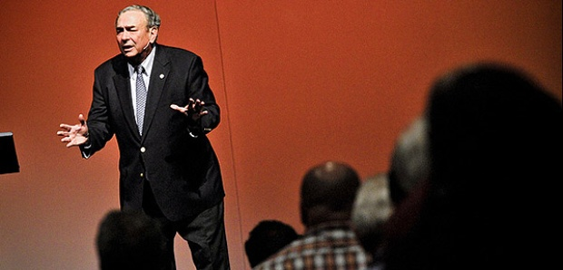
He descended from heaven before he ever ascended to heaven (Sproul, Might Christ, 23).
Daniel 7 is the Son of Man’s arrival; Acts 1:9 is the Son of Man’s departure.

Slide 142
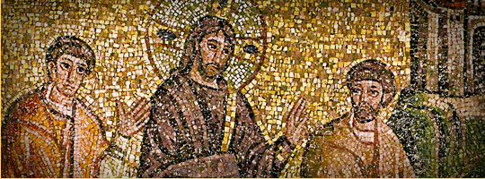
v. What Does Jesus’ being the “Son of Man” Mean for Us?

Slide 143
5. Conclusion: Transformation?
God’s Kingdom has broken into our world through the Son of Man
  Is this kingdom what we want or are we trying to establish our own dominion?

Slide 144
5. Conclusion: Transformation?
God’s Kingdom has broken into our world through the Son of Man
  Is this kingdom what we want or are we trying to establish our own dominion?
The Son of Man will descend again to complete his kingdom work eternally
  Is being with the Son of Man where we want to be for eternity?

Slide 145
5. Conclusion: Transformation?
God’s Kingdom has broken into our world through the Son of Man
  Is this kingdom what we want or are we trying to establish our own dominion?
The Son of Man will descend again to complete his kingdom work eternally
  Is being with the Son of Man where we want to be for eternity?
The Son of Man accomplishes his kingdom work through suffering
  We are to be like the Son of Man in all things—including his persecution (Luke 6:22)
  Do we want to be like him in all things? In a world that hates him?

Slide 146
5. Conclusion: Transformation?
God’s Kingdom has broken into our world through the Son of Man
  Is this kingdom what we want or are we trying to establish our own dominion?
The Son of Man will descend again to complete his kingdom work eternally
  Is being with the Son of Man where we want to be for eternity?
The Son of Man accomplishes his kingdom work through suffering
  We are to be like the Son of Man in all things—including his persecution (Luke 6:22)
  Do we want to be like him in all things? In a world that hates him?
Our response to his coming to serve should be to become servants of Christ
  How are we serving the Son of Man?

Slide 147
5. Conclusion: Transformation?
God’s Kingdom has broken into our world through the Son of Man
  Is this kingdom what we want or are we trying to establish our own dominion?
The Son of Man will descend again to complete his kingdom work eternally
  Is being with the Son of Man where we want to be for eternity?
The Son of Man accomplishes his kingdom work through suffering
  We are to be like the Son of Man in all things—including his persecution (Luke 6:22)
  Do we want to be like him in all things? In a world that hates him?
Our response to his coming to serve should be to become servants of Christ
  How are we serving the Son of Man?
We can become servants of Christ because the Son of Man has divine authority over sin and Sabbath
  overarching rule: both of that which is against God and by God

