Slide 1
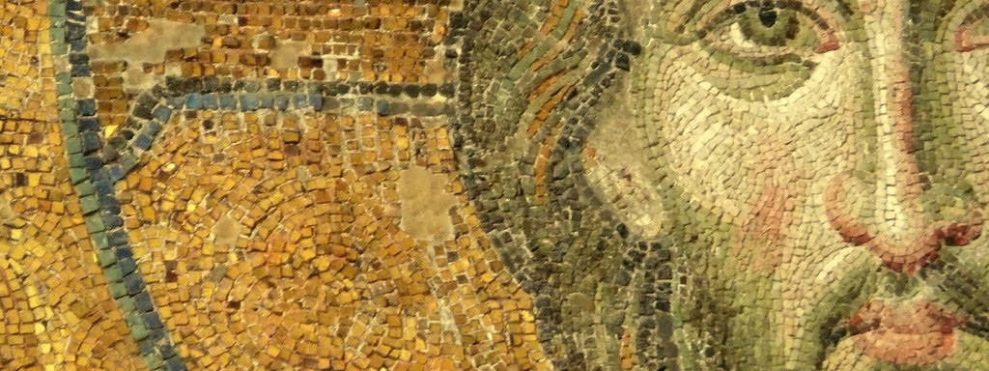
The Fullness of Christ:
Meditations on Our Multidimensional Messiah

Slide 2
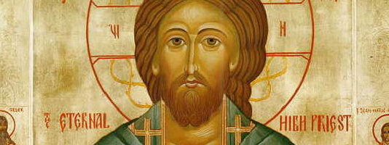
Lesson Four: Jesus, Our Great High Priest

Slide 3
What Is the office of Christ?

Slide 4
I. Introduction:
What is the office of Christ?

Slide 5
I. Introduction:
What is the office of Christ?
  Historically, theologians—building out of the NT—have conceptualized the work of Christ in terms of his atonement and his “office.”

Slide 6
I. Introduction:
What is the office of Christ?
  Historically, theologians—building out of the NT—have conceptualized the work of Christ in terms of his atonement and his “office.”
  His office, therefore, describes Jesus’ messianic work—what he does as the messiah

Slide 7
I. Introduction:
What is the office of Christ?
  Historically, theologians—building out of the NT—have conceptualized the work of Christ in terms of his atonement and his “office.”
  His office, therefore, describes Jesus’ messianic work—what he does as the messiah
  His messianic office is Three-fold:

Slide 8
I. Introduction:
What is the office of Christ?
  Historically, theologians—building out of the NT—have conceptualized the work of Christ in terms of his atonement and his “office.”
  His office, therefore, describes Jesus’ messianic work—what he does as the messiah
  His messianic office is Three-fold:
    Jesus as Prophet

Slide 9
I. Introduction:
What is the office of Christ?
  Historically, theologians—building out of the NT—have conceptualized the work of Christ in terms of his atonement and his “office.”
  His office, therefore, describes Jesus’ messianic work—what he does as the messiah
  His messianic office is Three-fold:
    Jesus as Prophet
    Jesus as Priest

Slide 10
I. Introduction:
What is the office of Christ?
  Historically, theologians—building out of the NT—have conceptualized the work of Christ in terms of his atonement and his “office.”
  His office, therefore, describes Jesus’ messianic work—what he does as the messiah
  His messianic office is Three-fold:
    Jesus as Prophet
    Jesus as Priest
    Jesus as King

Slide 11
I. Introduction:
What is the office of Christ?
Why does the office of Christ matter?

Slide 12
I. Introduction:
What is the office of Christ?
Why does the office of Christ matter?
  Who Jesus is and what Jesus does are inseparable

Slide 13
I. Introduction:
What is the office of Christ?
Why does the office of Christ matter?
  Who Jesus is and what Jesus does are inseparable
    If we want to know Jesus in his fullness we need to know who he is and also what he does

Slide 14
I. Introduction:
What is the office of Christ?
Why does the office of Christ matter?
  Who Jesus is and what Jesus does are inseparable
  Understanding the three-fold office of Christ helps us grasp the comprehensive nature of what Jesus has accomplished

Slide 15
I. Introduction:
What is the office of Christ?
Why does the office of Christ matter?
  Who Jesus is and what Jesus does are inseparable
  Understanding the three-fold office of Christ helps us grasp the comprehensive nature of what Jesus has accomplished
  It also helps us put our Bibles together as the three divine representatives in the Old Testament find their fulfillment in Jesus

Slide 16
I. Introduction:
What is the office of Christ?
Why does the office of Christ matter?
The Role of Prophet and Priest in the OT:

Slide 17
I. Introduction:
What is the office of Christ?
Why does the office of Christ matter?
The Role of Prophet and Priest in the OT:
  OT Prophets: Representatives of God before the people

Slide 18
I. Introduction:
What is the office of Christ?
Why does the office of Christ matter?
The Role of Prophet and Priest in the OT:
  OT Prophets: Representatives of God before the people
  OT Priests: Representatives of the people before God

Slide 19
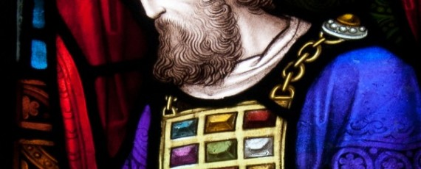
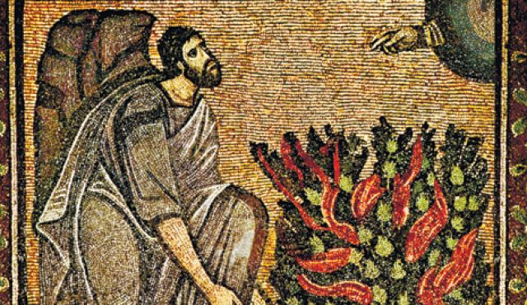
ii. Old Testament Background:
What is a Priest?

Slide 20
ii. What is a Priest?:
The Role of the Priest in the OT:

Slide 21
ii. What is a Priest?:
The Role of the Priest in the OT:
  Mediation: The priest stands between God and the people

Slide 22
ii. What is a Priest?:
The Role of the Priest in the OT:
  Mediation: The priest stands between God and the people
    Intercession: OT priests prayed to God on behalf of the people of God (Joel 2:17; Malachi 1:9)

Slide 23

  Between the vestibule and the altar
  let the priests, the ministers of the LORD, weep and say,
  “Spare your people, O LORD,
  and make not your heritage a reproach,
  a byword among the nations.
  Why should they say among the peoples, ‘Where is their God?’”(Joel 2:17 ESV)

Slide 24
ii. What is a Priest?:
The Role of the Priest in the OT:
  Mediation: The priest stands between God and the people
    Intercession: OT priests prayed to God on behalf of the people of God (Joel 2:17; Malachi 1:9)
    Benediction: OT priests declared the covenant blessings of the Lord to the people of God (Numbers 6:22-27)

Slide 25
  The LORD spoke to Moses, saying, “Speak to Aaron and his sons, saying, Thus you shall bless the people of Israel: you shall say to them, The LORD bless you and keep you; the LORD make his face to shine upon you and be gracious to you; the LORD lift up his countenance upon you and give you peace. “So shall they put my name upon the people of Israel, and I will bless them.”
  (Numbers 6:22-27 ESV)

Slide 26
ii. What is a Priest?:
The Role of the Priest in the OT:
  Mediation: The priest stands between God and the people
  Reconciliation: The work of the priest centers in the offering of sacrifice for the forgiveness of sin

Slide 27
ii. What is a Priest?:
The Role of the Priest in the OT:
  Mediation: The priest stands between God and the people
  Reconciliation: The work of the priest centers in the offering of sacrifice for the forgiveness of sin
    The priests offered sacrifices on behalf of Israel before God (bulls, goats, lambs, doves, flour, wine, oil)

Slide 28
ii. What is a Priest?:
The Role of the Priest in the OT:
  Mediation: The priest stands between God and the people
  Reconciliation: The work of the priest centers in the offering of sacrifice for the forgiveness of sin
    The priests offered sacrifices on behalf of Israel before God (bulls, goats, lambs, doves, flour, wine, oil)
    The sacrifices procure atonement: a work established to reconcile two contrary parties into oneness (at-one-ment)

Slide 29
ii. What is a Priest?:
The Role of the Priest in the OT:
  Mediation: The priest stands between God and the people
  Reconciliation: The work of the priest centers in the offering of sacrifice for the forgiveness of sin
    The priests offered sacrifices on behalf of Israel before God (bulls, goats, lambs, doves, flour, wine, oil)
    The sacrifices procure atonement: a work established to reconcile two contrary parties into oneness (at-one-ment)
    The sacrifice system required: A perfect animal/offering (Exod 12:5; 29:1; Lev 1:3): a sacrifice that was of extensive value

Slide 30
ii. What is a Priest?:
The Role of the Priest in the OT:
  Mediation: The priest stands between God and the people
  Reconciliation: The work of the priest centers in the offering of sacrifice for the forgiveness of sin
    The priests offered sacrifices on behalf of Israel before God (bulls, goats, lambs, doves, flour, wine, oil)
    The sacrifices procure atonement: a work established to reconcile two contrary parties into oneness (at-one-ment)
    The sacrifice system required: A perfect animal/offering (Exod 12:5; 29:1; Lev 1:3): a sacrifice that was of extensive value
    Pinnacle of the Priest’s Work: The Day of Atonement

Slide 31
  Leviticus 16: Pinnacle of the Priest’s Work
  Here is how you stand in my presence in the Holy of Holies inside the temple/tabernacle without dying
  The high priest (Aaron and those from his line) shall wash and put on the holy garments
  Bring a bull for a sin offering, a ram for a burnt offering, and two male goats from the congregation
    The bull: a sin offering for the high priest himself
    One goat shall be offered as a sacrifice for sin for the people to remove their uncleanness and transgressions
    The other goat (scapegoat) shall have the sins of the people transferred to it and sent out into the wilderness
  Upon completion of the sacrificial work, Aaron and the high priests shall remove the holy garments, bathe again, and then offer the burnt offerings of the ram for himself and the people.

Slide 32
ii. What is a Priest?:
The Role of the Priest in the OT:
Reason for Priesthood:

Slide 33
ii. What is a Priest?:
The Role of the Priest in the OT:
Reason for Priesthood:
  Universal Sinfulness of Man (Rom 3:11ff)

Slide 34
ii. What is a Priest?:
The Role of the Priest in the OT:
Reason for Priesthood:
  Universal Sinfulness of Man (Rom 3:11ff)
    When Israel is confronted by the law they are shown to be what they had always been: sinners

Slide 35
ii. What is a Priest?:
The Role of the Priest in the OT:
Reason for Priesthood:
  Universal Sinfulness of Man (Rom 3:11ff)
    When Israel is confronted by the law they are shown to be what they had always been: sinners
    This is why the law and priestly work are always connected—the law exposes sin and the work of the priest shows how this sin can and will be dealt with

Slide 36
ii. What is a Priest?:
The Role of the Priest in the OT:
Reason for Priesthood:
  Universal Sinfulness of Man (Rom 3:11ff)
    When Israel is confronted by the law they are shown to be what they had always been: sinners
    This is why the law and priestly work are always connected—the law exposes sin and the work of the priest shows how this sin can and will be dealt with
    Sinners need mediation if they are going to be in the presence of the Lord (Rom 7:10)

Slide 37
ii. What is a Priest?:
The Role of the Priest in the OT:
Reason for Priesthood:
  Universal Sinfulness of Man (Rom 3:11ff)
    When Israel is confronted by the law they are shown to be what they had always been: sinners
    This is why the law and priestly work are always connected—the law exposes sin and the work of the priest shows how this sin can and will be dealt with
    Sinners need mediation if they are going to be in the presence of the Lord (Rom 7:10)
      Sinners need a sacrifice to die for them because sin demands life and life is in the blood (Lev 17:11)

Slide 38
  For the life of the flesh is in the blood, and I have given it for you on the altar to make atonement for your souls, for it is the blood that makes atonement by the life.
  (Leviticus 17:11 ESV)

Slide 39
ii. What is a Priest?:
The Role of the Priest in the OT:
Reason for Priesthood:
  Universal Sinfulness of Man (Rom 3:11ff)
  God’s Covenant Promises

Slide 40
ii. What is a Priest?:
The Role of the Priest in the OT:
Reason for Priesthood:
  Universal Sinfulness of Man (Rom 3:11ff)
  God’s Covenant Promises
    Remember who establishes the Priesthood and the Sacrificial System: The Lord—he is the one who provides salvation (Jonah 2:9; Ps 37:39)

Slide 41
  The salvation of the righteous is from the LORD; he is their stronghold in the time of trouble.
  (Psalm 37:39 ESV)
  But I with the voice of thanksgiving
  will sacrifice to you; what I have vowed I will pay.
  Salvation belongs to the LORD!”(Jonah 2:9 ESV)

Slide 42
ii. What is a Priest?:
The Role of the Priest in the OT:
Reason for Priesthood:
  Universal Sinfulness of Man (Rom 3:11ff)
  God’s Covenant Promises
    Remember who establishes the Priesthood and the Sacrificial System: The Lord—he is the one who provides salvation (Jonah 2:9; Ps 37:39)
    God establishes these institutions to be with his people, to guide them, and to bring about his redemptive purposes and covenant promises

Slide 43
ii. What is a Priest?:
The Role of the Priest in the OT:
Reason for Priesthood:
Limitations of OT Priesthood:

Slide 44
ii. What is a Priest?:
The Role of the Priest in the OT:
Reason for Priesthood:
Limitations of OT Priesthood:
  OT Priests were Mortal and Sinful (Heb 7:23):

Slide 45
ii. What is a Priest?:
The Role of the Priest in the OT:
Reason for Priesthood:
Limitations of OT Priesthood:
  OT Priests were Mortal and Sinful (Heb 7:23):
    The need for a priestly succession plan demonstrates that the priests were mired in sin themselves

Slide 46
ii. What is a Priest?:
The Role of the Priest in the OT:
Reason for Priesthood:
Limitations of OT Priesthood:
  OT Priests were Mortal and Sinful (Heb 7:23):
    The need for a priestly succession plan demonstrates that the priests were mired in sin themselves
    Death was their end as it is the end of all sinners since Adam

Slide 47
ii. What is a Priest?:
The Role of the Priest in the OT:
Reason for Priesthood:
Limitations of OT Priesthood:
  OT Priests were Mortal and Sinful (Heb 7:23):
    The need for a priestly succession plan demonstrates that the priests were mired in sin themselves
    Death was their end as it is the end of all sinners since Adam
    Moreover, before offering atonement for the people, the priests first had to atone for their own sins

Slide 48
ii. What is a Priest?:
The Role of the Priest in the OT:
Reason for Priesthood:
Limitations of OT Priesthood:
  OT Priests were Mortal and Sinful (Heb 7:23):
  The Constant Repetition of the Sacrificial System Reveals its Inability to Take Away Sin:

Slide 49
ii. What is a Priest?:
The Role of the Priest in the OT:
Reason for Priesthood:
Limitations of OT Priesthood:
  OT Priests were Mortal and Sinful (Heb 7:23):
  The Constant Repetition of the Sacrificial System Reveals its Inability to Take Away Sin:
    Priesthood is preparatory: Portrays the principle for atonement but can never complete the requirements for that atonement within its own system

Slide 50
ii. What is a Priest?:
The Role of the Priest in the OT:
Reason for Priesthood:
Limitations of OT Priesthood:
  OT Priests were Mortal and Sinful (Heb 7:23):
  The Constant Repetition of the Sacrificial System Reveals its Inability to Take Away Sin:
  The Sacrifices of the Sacrificial System Reveal its Inability to Take Away Sin:

Slide 51
ii. What is a Priest?:
The Role of the Priest in the OT:
Reason for Priesthood:
Limitations of OT Priesthood:
  OT Priests were Mortal and Sinful (Heb 7:23):
  The Constant Repetition of the Sacrificial System Reveals its Inability to Take Away Sin:
  The Sacrifices of the Sacrificial System Reveal its Inability to Take Away Sin:
    Animals cannot take away the sins of man

Slide 52
ii. What is a Priest?:
The Role of the Priest in the OT:
Reason for Priesthood:
Limitations of OT Priesthood:
  OT Priests were Mortal and Sinful (Heb 7:23):
  The Constant Repetition of the Sacrificial System Reveals its Inability to Take Away Sin:
  The Sacrifices of the Sacrificial System Reveal its Inability to Take Away Sin:
    Animals cannot take away the sins of man
    The transference of man’s sin to the bull or goat only goes so far

Slide 53
ii. What is a Priest?:
The Role of the Priest in the OT:
Reason for Priesthood:
Limitations of OT Priesthood:
  OT Priests were Mortal and Sinful (Heb 7:23):
  The Constant Repetition of the Sacrificial System Reveals its Inability to Take Away Sin:
  The Sacrifices of the Sacrificial System Reveal its Inability to Take Away Sin:
  The Sacrificial System is an earthly reality alone and yet sin is against our God in heaven

Slide 54
ii. What is a Priest?:
The Role of the Priest in the OT:
Reason for Priesthood:
Limitations of OT Priesthood:
  OT Priests were Mortal and Sinful (Heb 7:23):
  The Constant Repetition of the Sacrificial System Reveals its Inability to Take Away Sin:
  The Sacrifices of the Sacrificial System Reveal its Inability to Take Away Sin:
  The Sacrificial System is an earthly reality alone and yet sin is against our God in heaven
  The OT Priesthood Demanded a Better Priestly Order: Psalm 110:4

Slide 55
  The LORD has sworn
  and will not change his mind,
  “You are a priest forever
  after the order of Melchizedek.”
  (Psalm 110:4 ESV)

Slide 56
ii. What is a Priest?:
The Role of the Priest in the OT:
Reason for Priesthood:
Limitations of OT Priesthood:
  OT Priests were Mortal and Sinful (Heb 7:23):
  The Constant Repetition of the Sacrificial System Reveals its Inability to Take Away Sin:
  The Sacrifices of the Sacrificial System Reveal its Inability to Take Away Sin:
  The Sacrificial System is an earthly reality alone and yet sin is against our God in heaven
  The OT Priesthood Demanded a Better Priestly Order: Psalm 110:4
    If the existing priesthood worked, there would be no need for this other priestly order (Heb 7:11ff).

Slide 57
ii. What is a Priest?:
The Role of the Priest in the OT:
Reason for Priesthood:
Limitations of OT Priesthood:
  OT Priests were Mortal and Sinful (Heb 7:23):
  The Constant Repetition of the Sacrificial System Reveals its Inability to Take Away Sin:
  The Sacrifices of the Sacrificial System Reveal its Inability to Take Away Sin:
  The Sacrificial System is an earthly reality alone and yet sin is against our God in heaven
  The OT Priesthood Demanded a Better Priestly Order: Psalm 110:4
  The Promise of a New Covenant Makes the OT Priesthood Obsolete (Jer 31:31ff; Heb 8:7)

Slide 58
ii. What is a Priest?:
The Role of the Priest in the OT:
Reason for Priesthood:
Limitations of OT Priesthood:
  OT Priests were Mortal and Sinful (Heb 7:23):
  The Constant Repetition of the Sacrificial System Reveals its Inability to Take Away Sin:
  The Sacrifices of the Sacrificial System Reveal its Inability to Take Away Sin:
  The Sacrificial System is an earthly reality alone and yet sin is against our God in heaven
  The OT Priesthood Demanded a Better Priestly Order: Psalm 110:4
  The Promise of a New Covenant Makes the OT Priesthood Obsolete (Jer 31:31ff; Heb 8:7)
    The external law becomes internal: The law is written on the heart

Slide 59
ii. What is a Priest?:
The Role of the Priest in the OT:
Reason for Priesthood:
Limitations of OT Priesthood:
  OT Priests were Mortal and Sinful (Heb 7:23):
  The Constant Repetition of the Sacrificial System Reveals its Inability to Take Away Sin:
  The Sacrifices of the Sacrificial System Reveal its Inability to Take Away Sin:
  The Sacrificial System is an earthly reality alone and yet sin is against our God in heaven
  The OT Priesthood Demanded a Better Priestly Order: Psalm 110:4
  The Promise of a New Covenant Makes the OT Priesthood Obsolete (Jer 31:31ff; Heb 8:7)
    The external law becomes internal: The law is written on the heart
    Sins will be removed forever

Slide 60
ii. What is a Priest?:
The Role of the Priest in the OT:
Reason for Priesthood:
Limitations of OT Priesthood:
  OT Priests were Mortal and Sinful (Heb 7:23):
  The Constant Repetition of the Sacrificial System Reveals its Inability to Take Away Sin:
  The Sacrifices of the Sacrificial System Reveal its Inability to Take Away Sin:
  The Sacrificial System is an earthly reality alone and yet sin is against our God in heaven
  The OT Priesthood Demanded a Better Priestly Order: Psalm 110:4
  The Promise of a New Covenant Makes the OT Priesthood Obsolete (Jer 31:31ff; Heb 8:7)
  Conclusion: The OT Priesthood does not accomplish a full atonement but points forward to a better priest, a better sacrifice, a better mediator, and a better intercessor.

Slide 61
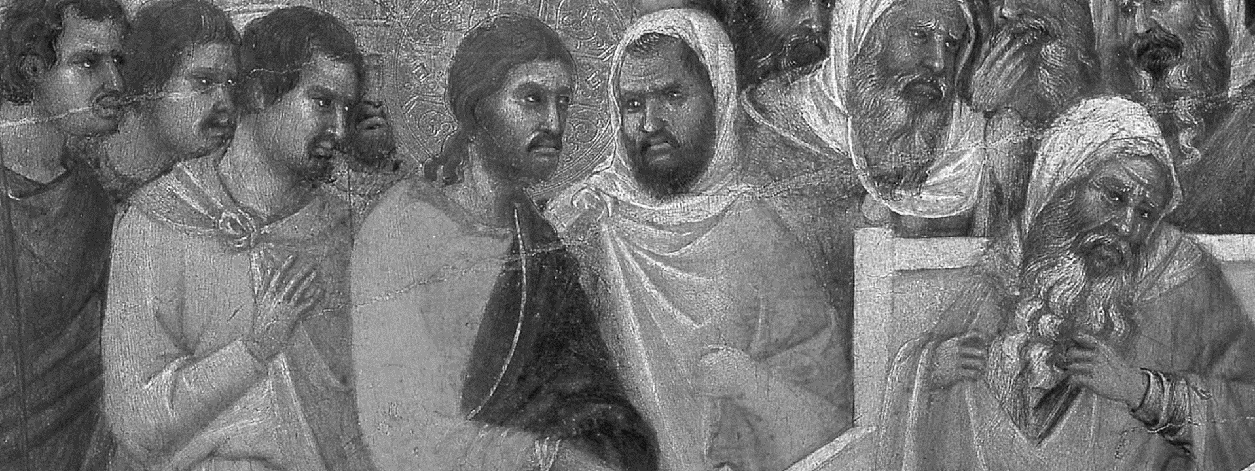
iiI. New Testament realities:
How is Jesus the Great High Priest?

Slide 62
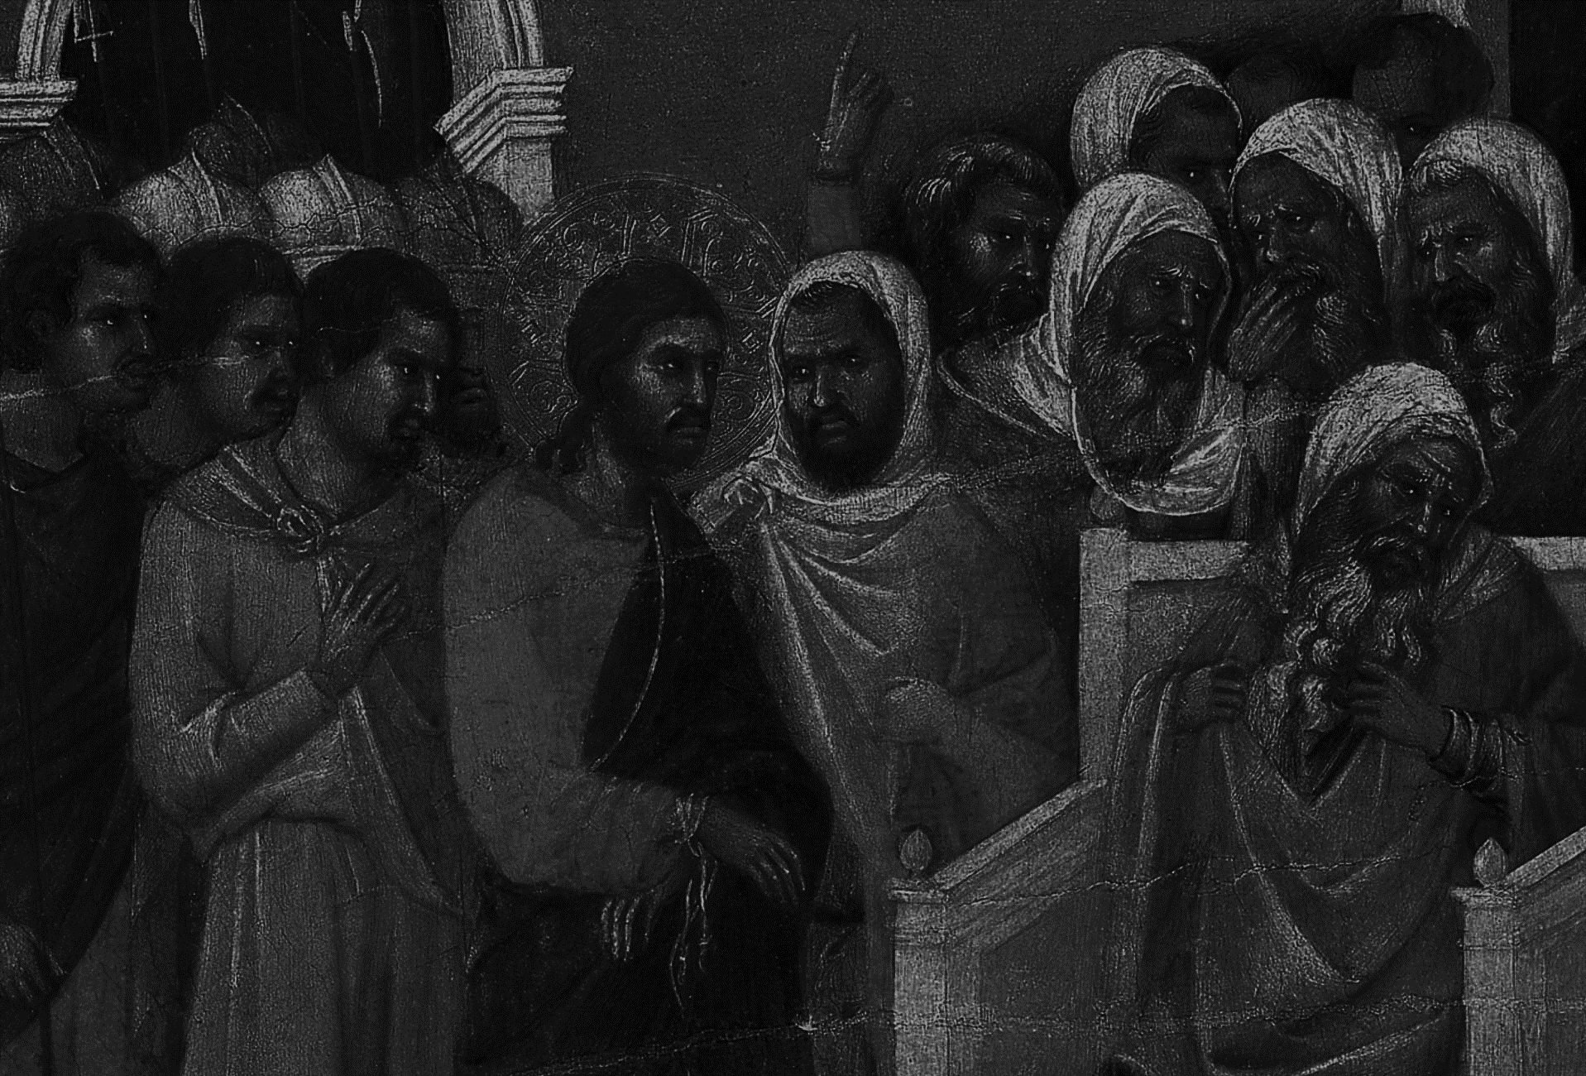
III. New Testament Realities:
Jesus demonstrates his priestly work as an intercessor

Slide 63
III. New Testament Realities:
Jesus demonstrates his priestly work as an intercessor
  Jesus prays for Peter (Luke 22:21-32)

Slide 64
III. New Testament Realities:
Jesus demonstrates his priestly work as an intercessor
  Jesus prays for Peter (Luke 22:21-32)
  He promises to intercede with the Father on behalf of his disciples in order that the Spirit/Paraclete will come (John 14:16)

Slide 65
III. New Testament Realities:
Jesus demonstrates his priestly work as an intercessor
  Jesus prays for Peter (Luke 22:21-32)
  He promises to intercede with the Father on behalf of his disciples in order that the Spirit/Paraclete will come (John 14:16)
  John 17 is known as Jesus’ High Priestly Prayer because it is a detailed expression of Christ’s intercession

Slide 66
III. New Testament Realities:
Jesus demonstrates his priestly work as an intercessor
  Jesus prays for Peter (Luke 22:21-32)
  He promises to intercede with the Father on behalf of his disciples in order that the Spirit/Paraclete will come (John 14:16)
  John 17 is known as Jesus’ High Priestly Prayer because it is a detailed expression of Christ’s intercession
Jesus’ work is marked with priest-like benedictions (Luke 24:51; John 20:19)

Slide 67
  On the evening of that day, the first day of the week, the doors being locked where the disciples were for fear of the Jews, Jesus came and stood among them and said to them, “Peace be with you.”
  (John 20:19 ESV)

Slide 68
III. New Testament Realities:
Jesus demonstrates his priestly work as an intercessor
  Jesus prays for Peter (Luke 22:21-32)
  He promises to intercede with the Father on behalf of his disciples in order that the Spirit/Paraclete will come (John 14:16)
  John 17 is known as Jesus’ High Priestly Prayer because it is a detailed expression of Christ’s intercession
Jesus’ work is marked with priest-like benedictions (Luke 24:51; John 20:19)
Christ’s sinless humanity cast him as the perfect sacrifice:

Slide 69
III. New Testament Realities:
Jesus demonstrates his priestly work as an intercessor
  Jesus prays for Peter (Luke 22:21-32)
  He promises to intercede with the Father on behalf of his disciples in order that the Spirit/Paraclete will come (John 14:16)
  John 17 is known as Jesus’ High Priestly Prayer because it is a detailed expression of Christ’s intercession
Jesus’ work is marked with priest-like benedictions (Luke 24:51; John 20:19)
Christ’s sinless humanity cast him as the perfect sacrifice:
  Christ’s sinlessness is a priestly reality: He is the perfect, spotless sacrifice (2 Cor 5:21; 1 Pet 2:21-25; 3:18; 1 John 3:5,7)

Slide 70
III. New Testament Realities:
Jesus demonstrates his priestly work as an intercessor
  Jesus prays for Peter (Luke 22:21-32)
  He promises to intercede with the Father on behalf of his disciples in order that the Spirit/Paraclete will come (John 14:16)
  John 17 is known as Jesus’ High Priestly Prayer because it is a detailed expression of Christ’s intercession
Jesus’ work is marked with priest-like benedictions (Luke 24:51; John 20:19)
Christ’s sinless humanity cast him as the perfect sacrifice:
  Christ’s sinlessness is a priestly reality: He is the perfect, spotless sacrifice (2 Cor 5:21; 1 Pet 2:21-25; 3:18; 1 John 3:5,7)
  Christ’s humanity is a priestly reality: Christ takes on flesh in order to redeem men and women

Slide 71
III. New Testament Realities:
Jesus demonstrates his priestly work as an intercessor
  Jesus prays for Peter (Luke 22:21-32)
  He promises to intercede with the Father on behalf of his disciples in order that the Spirit/Paraclete will come (John 14:16)
  John 17 is known as Jesus’ High Priestly Prayer because it is a detailed expression of Christ’s intercession
Jesus’ work is marked with priest-like benedictions (Luke 24:51; John 20:19)
Christ’s sinless humanity cast him as the perfect sacrifice:
  Christ’s sinlessness is a priestly reality: He is the perfect, spotless sacrifice (2 Cor 5:21; 1 Pet 2:21-25; 3:18; 1 John 3:5,7)
  Christ’s humanity is a priestly reality: Christ takes on flesh in order to redeem men and women
Jesus casts his impending death within the priestly work of the new covenant sacrifice

Slide 72
III. New Testament Realities:
Jesus demonstrates his priestly work as an intercessor
  Jesus prays for Peter (Luke 22:21-32)
  He promises to intercede with the Father on behalf of his disciples in order that the Spirit/Paraclete will come (John 14:16)
  John 17 is known as Jesus’ High Priestly Prayer because it is a detailed expression of Christ’s intercession
Jesus’ work is marked with priest-like benedictions (Luke 24:51; John 20:19)
Christ’s sinless humanity cast him as the perfect sacrifice:
  Christ’s sinlessness is a priestly reality: He is the perfect, spotless sacrifice (2 Cor 5:21; 1 Pet 2:21-25; 3:18; 1 John 3:5,7)
  Christ’s humanity is a priestly reality: Christ takes on flesh in order to redeem men and women
Jesus casts his impending death within the priestly work of the new covenant sacrifice
  Jesus presents his cross-work within the priestly categories of sacrifice (John 1:29,36)

Slide 73
  The next day he saw Jesus coming toward him, and said, “Behold, the Lamb of God, who takes away the sin of the world!
  (John 1:29 ESV)

Slide 74
III. New Testament Realities:
Jesus demonstrates his priestly work as an intercessor
  Jesus prays for Peter (Luke 22:21-32)
  He promises to intercede with the Father on behalf of his disciples in order that the Spirit/Paraclete will come (John 14:16)
  John 17 is known as Jesus’ High Priestly Prayer because it is a detailed expression of Christ’s intercession
Jesus’ work is marked with priest-like benedictions (Luke 24:51; John 20:19)
Christ’s sinless humanity cast him as the perfect sacrifice:
  Christ’s sinlessness is a priestly reality: He is the perfect, spotless sacrifice (2 Cor 5:21; 1 Pet 2:21-25; 3:18; 1 John 3:5,7)
  Christ’s humanity is a priestly reality: Christ takes on flesh in order to redeem men and women
Jesus casts his impending death within the priestly work of the new covenant sacrifice
  Jesus presents his cross-work within the priestly categories of sacrifice (John 1:29,36)
  The Lord’s Supper: This is my body broken for you; this is my blood shed for you.

Slide 75
III. New Testament Realities:
Jesus demonstrates his priestly work as an intercessor
  Jesus prays for Peter (Luke 22:21-32)
  He promises to intercede with the Father on behalf of his disciples in order that the Spirit/Paraclete will come (John 14:16)
  John 17 is known as Jesus’ High Priestly Prayer because it is a detailed expression of Christ’s intercession
Jesus’ work is marked with priest-like benedictions (Luke 24:51; John 20:19)
Christ’s sinless humanity cast him as the perfect sacrifice:
  Christ’s sinlessness is a priestly reality: He is the perfect, spotless sacrifice (2 Cor 5:21; 1 Pet 2:21-25; 3:18; 1 John 3:5,7)
  Christ’s humanity is a priestly reality: Christ takes on flesh in order to redeem men and women
Jesus casts his impending death within the priestly work of the new covenant sacrifice
  Jesus presents his cross-work within the priestly categories of sacrifice (John 1:29,36)
  The Lord’s Supper: This is my body broken for you; this is my blood shed for you.
  The whole NT sees Christ’s death in priestly/sacrificial terms (1 Cor 5:7; Eph 5:2; 1 Pet 1:9; Rev 5:6-6:5; 12:11; 14:1; 19:6-10; 21:9-14; 22:1-5)

Slide 76
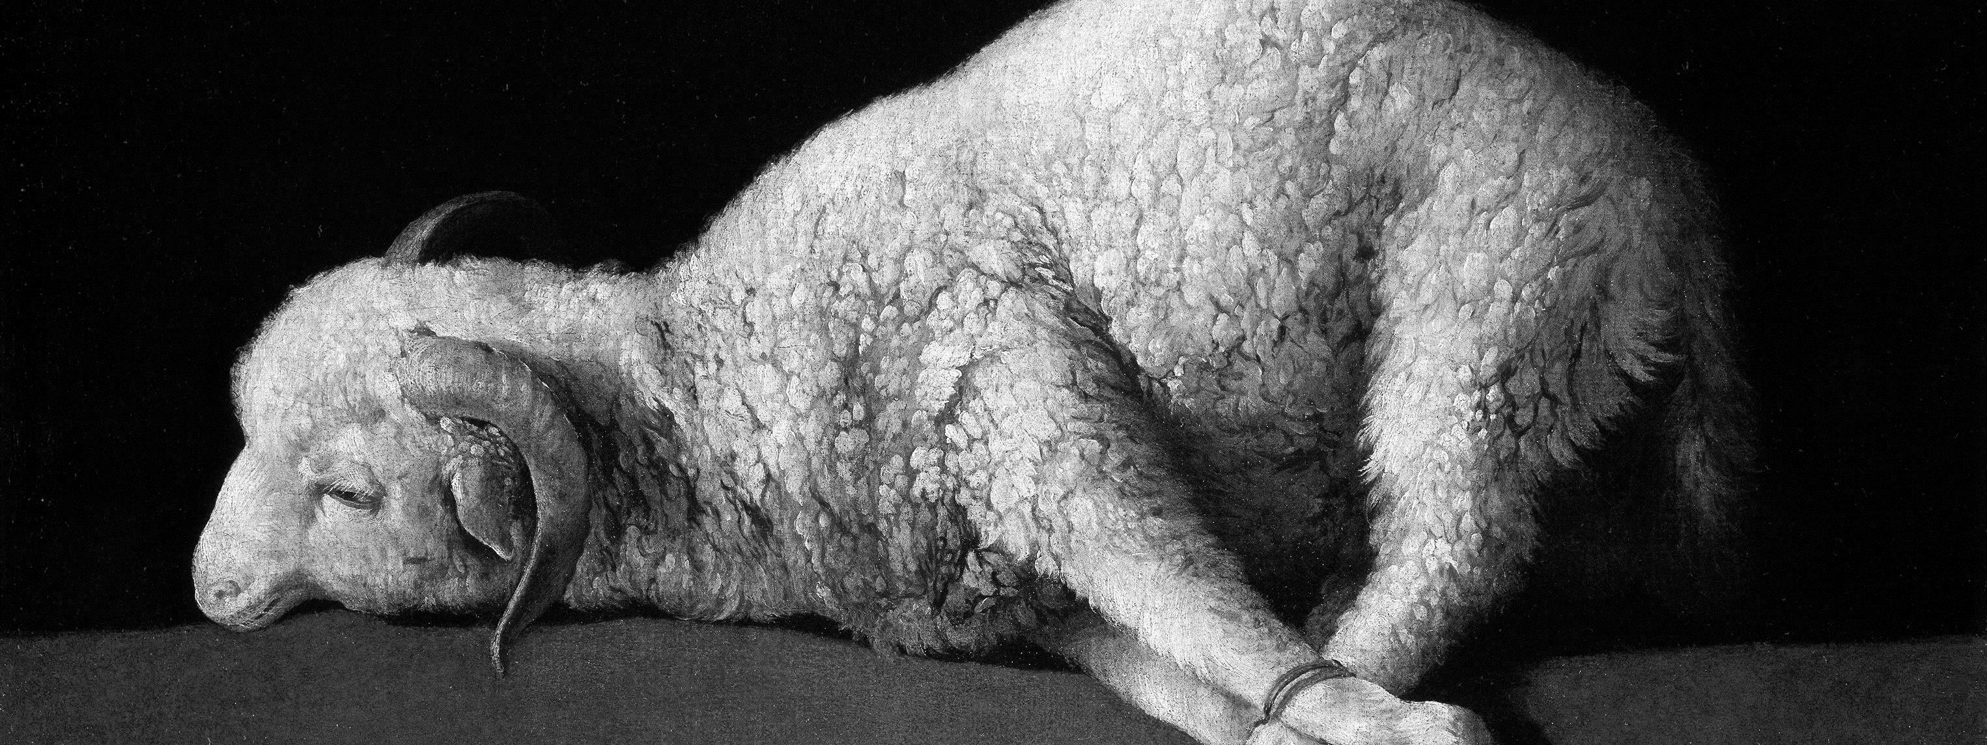
iV. Theological Significance:
Why is Jesus the Great High Priest?

Slide 77
IV. Theological Significance:
As our Great High Priest, Jesus is what all the OT Priesthood and Sacrificial System was preparing us for

Slide 78
IV. Theological Significance:
As our Great High Priest, Jesus is what all the OT Priesthood and Sacrificial System was preparing us for
As our Great High Priest, Jesus is the Better Priest and the Better Sacrifice:

Slide 79
IV. Theological Significance:
As our Great High Priest, Jesus is what all the OT Priesthood and Sacrificial System was preparing us for
As our Great High Priest, Jesus is the Better Priest and the Better Sacrifice:
  Jesus is the Better High Priest

Slide 80
IV. Theological Significance:
As our Great High Priest, Jesus is what all the OT Priesthood and Sacrificial System was preparing us for
As our Great High Priest, Jesus is the Better Priest and the Better Sacrifice:
  Jesus is the Better High Priest
    OT Priests were Mortal and Sinful but Jesus is Eternal and Sinless (Heb 7:23; Heb 5:3; 7:27; Ps 110:4)

Slide 81
IV. Theological Significance:
As our Great High Priest, Jesus is what all the OT Priesthood and Sacrificial System was preparing us for
As our Great High Priest, Jesus is the Better Priest and the Better Sacrifice:
  Jesus is the Better High Priest
    OT Priests were Mortal and Sinful but Jesus is Eternal and Sinless (Heb 7:23; Heb 5:3; 7:27; Ps 110:4)
    Jesus’ priestly work is both heavenly and earthly (Heb 9:11)

Slide 82
IV. Theological Significance:
As our Great High Priest, Jesus is what all the OT Priesthood and Sacrificial System was preparing us for
As our Great High Priest, Jesus is the Better Priest and the Better Sacrifice:
  Jesus is the Better High Priest
    OT Priests were Mortal and Sinful but Jesus is Eternal and Sinless (Heb 7:23; Heb 5:3; 7:27; Ps 110:4)
    Jesus’ priestly work is both heavenly and earthly (Heb 9:11)
      The Sacrificial System is an earthly reality alone and yet sin is against our God in heaven

Slide 83
IV. Theological Significance:
As our Great High Priest, Jesus is what all the OT Priesthood and Sacrificial System was preparing us for
As our Great High Priest, Jesus is the Better Priest and the Better Sacrifice:
  Jesus is the Better High Priest
    OT Priests were Mortal and Sinful but Jesus is Eternal and Sinless (Heb 7:23; Heb 5:3; 7:27; Ps 110:4)
    Jesus’ priestly work is both heavenly and earthly (Heb 9:11)
      The Sacrificial System is an earthly reality alone and yet sin is against our God in heaven
    The OT Priesthood needs a Better Priestly Order (Psalm 110:4; Heb 7:11ff)

Slide 84
IV. Theological Significance:
As our Great High Priest, Jesus is what all the OT Priesthood and Sacrificial System was preparing us for
As our Great High Priest, Jesus is the Better Priest and the Better Sacrifice:
  Jesus is the Better High Priest
    OT Priests were Mortal and Sinful but Jesus is Eternal and Sinless (Heb 7:23; Heb 5:3; 7:27; Ps 110:4)
    Jesus’ priestly work is both heavenly and earthly (Heb 9:11)
      The Sacrificial System is an earthly reality alone and yet sin is against our God in heaven
    The OT Priesthood needs a Better Priestly Order (Psalm 110:4; Heb 7:11ff)
      Jesus’s priesthood comes from Melchizedek (Gen 14; Psalm 110)

Slide 85
IV. Theological Significance:
As our Great High Priest, Jesus is what all the OT Priesthood and Sacrificial System was preparing us for
As our Great High Priest, Jesus is the Better Priest and the Better Sacrifice:
  Jesus is the Better High Priest
    OT Priests were Mortal and Sinful but Jesus is Eternal and Sinless (Heb 7:23; Heb 5:3; 7:27; Ps 110:4)
    Jesus’ priestly work is both heavenly and earthly (Heb 9:11)
      The Sacrificial System is an earthly reality alone and yet sin is against our God in heaven
    The OT Priesthood needs a Better Priestly Order (Psalm 110:4; Heb 7:11ff)
      Jesus’s priesthood comes from Melchizedek (Gen 14; Psalm 110)
        King of righteousness

Slide 86
IV. Theological Significance:
As our Great High Priest, Jesus is what all the OT Priesthood and Sacrificial System was preparing us for
As our Great High Priest, Jesus is the Better Priest and the Better Sacrifice:
  Jesus is the Better High Priest
    OT Priests were Mortal and Sinful but Jesus is Eternal and Sinless (Heb 7:23; Heb 5:3; 7:27; Ps 110:4)
    Jesus’ priestly work is both heavenly and earthly (Heb 9:11)
      The Sacrificial System is an earthly reality alone and yet sin is against our God in heaven
    The OT Priesthood needs a Better Priestly Order (Psalm 110:4; Heb 7:11ff)
      Jesus’s priesthood comes from Melchizedek (Gen 14; Psalm 110)
        King of righteousness
        Without father, mother, genealogy

Slide 87
IV. Theological Significance:
As our Great High Priest, Jesus is what all the OT Priesthood and Sacrificial System was preparing us for
As our Great High Priest, Jesus is the Better Priest and the Better Sacrifice:
  Jesus is the Better High Priest
    OT Priests were Mortal and Sinful but Jesus is Eternal and Sinless (Heb 7:23; Heb 5:3; 7:27; Ps 110:4)
    Jesus’ priestly work is both heavenly and earthly (Heb 9:11)
      The Sacrificial System is an earthly reality alone and yet sin is against our God in heaven
    The OT Priesthood needs a Better Priestly Order (Psalm 110:4; Heb 7:11ff)
      Jesus’s priesthood comes from Melchizedek (Gen 14; Psalm 110)
        King of righteousness
        Without father, mother, genealogy
    ii. Like the son of God: he is one of greatness; one before the Levitical line and whose priesthood is beyond that of Aaron/Levi

Slide 88
IV. Theological Significance:
As our Great High Priest, Jesus is what all the OT Priesthood and Sacrificial System was preparing us for
As our Great High Priest, Jesus is the Better Priest and the Better Sacrifice:
  Jesus is the Better High Priest
  Jesus is the Better Sacrifice:

Slide 89
IV. Theological Significance:
As our Great High Priest, Jesus is what all the OT Priesthood and Sacrificial System was preparing us for
As our Great High Priest, Jesus is the Better Priest and the Better Sacrifice:
  Jesus is the Better High Priest
  Jesus is the Better Sacrifice:
    The Constant Repetition of the OT Sacrificial System Is replaced with the Once and For All Sacrifice of Jesus (Heb 10:1-2; Ephesians 5:2; Hebrews 9:26-27, 10:12; 1 John 1:7)

Slide 90
IV. Theological Significance:
As our Great High Priest, Jesus is what all the OT Priesthood and Sacrificial System was preparing us for
As our Great High Priest, Jesus is the Better Priest and the Better Sacrifice:
  Jesus is the Better High Priest
  Jesus is the Better Sacrifice:
    The Constant Repetition of the OT Sacrificial System Is replaced with the Once and For All Sacrifice of Jesus (Heb 10:1-2; Ephesians 5:2; Hebrews 9:26-27, 10:12; 1 John 1:7)
    Jesus sacrifice is perfect and spotless (Heb 9:14; 1 Pet 1:19)—not only externally but in his moral and sinless nature

Slide 91
IV. Theological Significance:
As our Great High Priest, Jesus is what all the OT Priesthood and Sacrificial System was preparing us for
As our Great High Priest, Jesus is the Better Priest and the Better Sacrifice:
  Jesus is the Better High Priest
  Jesus is the Better Sacrifice:
    The Constant Repetition of the OT Sacrificial System Is replaced with the Once and For All Sacrifice of Jesus (Heb 10:1-2; Ephesians 5:2; Hebrews 9:26-27, 10:12; 1 John 1:7)
    Jesus sacrifice is perfect and spotless (Heb 9:14; 1 Pet 1:19)—not only externally but in his moral and sinless nature
    The Animal Sacrifices are unable to remove human sin but Jesus’ Humanity makes him the perfect sacrifice (Heb 10:4)

Slide 92
IV. Theological Significance:
As our Great High Priest, Jesus is what all the OT Priesthood and Sacrificial System was preparing us for
As our Great High Priest, Jesus is the Better Priest and the Better Sacrifice:
  Jesus is the Better High Priest
  Jesus is the Better Sacrifice
  Summary:

Slide 93
IV. Theological Significance:
As our Great High Priest, Jesus is what all the OT Priesthood and Sacrificial System was preparing us for
As our Great High Priest, Jesus is the Better Priest and the Better Sacrifice:
  Jesus is the Better High Priest
  Jesus is the Better Sacrifice
  Summary:
    OT Priests are many in number; Jesus is one (Heb 7:23-24)

Slide 94
IV. Theological Significance:
As our Great High Priest, Jesus is what all the OT Priesthood and Sacrificial System was preparing us for
As our Great High Priest, Jesus is the Better Priest and the Better Sacrifice:
  Jesus is the Better High Priest
  Jesus is the Better Sacrifice
  Summary:
    OT Priests are many in number; Jesus is one (Heb 7:23-24)
    OT Priests are temporary; Jesus is permanent and eternal (Heb 7:23-24)

Slide 95
IV. Theological Significance:
As our Great High Priest, Jesus is what all the OT Priesthood and Sacrificial System was preparing us for
As our Great High Priest, Jesus is the Better Priest and the Better Sacrifice:
  Jesus is the Better High Priest
  Jesus is the Better Sacrifice
  Summary:
    OT Priests are many in number; Jesus is one (Heb 7:23-24)
    OT Priests are temporary; Jesus is permanent and eternal (Heb 7:23-24)
    OT Priests are sinners who needed to sacrifice for their own sins; Jesus is holy and perfect and offers a sacrifice for others only (Heb 7:26-27)

Slide 96
IV. Theological Significance:
As our Great High Priest, Jesus is what all the OT Priesthood and Sacrificial System was preparing us for
As our Great High Priest, Jesus is the Better Priest and the Better Sacrifice:
  Jesus is the Better High Priest
  Jesus is the Better Sacrifice
  Summary:
    OT Priests are many in number; Jesus is one (Heb 7:23-24)
    OT Priests are temporary; Jesus is permanent and eternal (Heb 7:23-24)
    OT Priests are sinners who needed to sacrifice for their own sins; Jesus is holy and perfect and offers a sacrifice for others only (Heb 7:26-27)
    OT Priests had to sacrifice daily; Jesus ‘ sacrifice is once and for all (Heb 7:27)

Slide 97
IV. Theological Significance:
As our Great High Priest, Jesus is what all the OT Priesthood and Sacrificial System was preparing us for
As our Great High Priest, Jesus is the Better Priest and the Better Sacrifice:
  Jesus is the Better High Priest
  Jesus is the Better Sacrifice
  Summary:
    OT Priests are many in number; Jesus is one (Heb 7:23-24)
    OT Priests are temporary; Jesus is permanent and eternal (Heb 7:23-24)
    OT Priests are sinners who needed to sacrifice for their own sins; Jesus is holy and perfect and offers a sacrifice for others only (Heb 7:26-27)
    OT Priests had to sacrifice daily; Jesus ‘ sacrifice is once and for all (Heb 7:27)
    OT Priests offered animals; Jesus offers up himself (Heb 7:27; 9:11-14)

Slide 98
IV. Theological Significance:
As our Great High Priest, Jesus is what all the OT Priesthood and Sacrificial System was preparing us for
As our Great High Priest, Jesus is the Better Priest and the Better Sacrifice:
  Jesus is the Better High Priest
  Jesus is the Better Sacrifice
  Summary:
    OT Priests are many in number; Jesus is one (Heb 7:23-24)
    OT Priests are temporary; Jesus is permanent and eternal (Heb 7:23-24)
    OT Priests are sinners who needed to sacrifice for their own sins; Jesus is holy and perfect and offers a sacrifice for others only (Heb 7:26-27)
    OT Priests had to sacrifice daily; Jesus ‘ sacrifice is once and for all (Heb 7:27)
    OT Priests offered animals; Jesus offers up himself (Heb 7:27; 9:11-14)
    OT Priests entered the holy places through a man-made tent and by means of the blood of goats and calves; Jesus entered the holy place of the presence of God through the means of his own blood (Heb 9:11-12)

Slide 99
IV. Theological Significance:
As our Great High Priest, Jesus is what all the OT Priesthood and Sacrificial System was preparing us for
As our Great High Priest, Jesus is the Better Priest and the Better Sacrifice
As our Great High Priest, Jesus is our only hope to draw near to God: (Rom 5:2; Eph 2:18; 3:12)

Slide 100
  Through him we have also obtained access by faith into this grace in which we stand, and we rejoice in hope of the glory of God. (Romans 5:2 ESV)
  For through him we both have access in one Spirit to the Father. (Ephesians 2:18 ESV)
  This was according to the eternal purpose that he has realized in Christ Jesus our Lord, in whom we have boldness and access with confidence through our faith in him. (Ephesians 3:11-12 ESV)

Slide 101
IV. Theological Significance:
As our Great High Priest, Jesus is what all the OT Priesthood and Sacrificial System was preparing us for
As our Great High Priest, Jesus is the Better Priest and the Better Sacrifice
As our Great High Priest, Jesus is our only hope to draw near to God: (Rom 5:2; Eph 2:18; 3:12)
  Jesus does his High Priestly work to make away for sinners to draw near to their Holy God (Heb 4:16; 7:25; 10:1, 22; 11:6; 12:18, 22)

Slide 102
  Let us then with confidence draw near to the throne of grace, that we may receive mercy and find grace to help in time of need.
  (Hebrews 4:16 ESV)

Slide 103
IV. Theological Significance:
As our Great High Priest, Jesus is what all the OT Priesthood and Sacrificial System was preparing us for
As our Great High Priest, Jesus is the Better Priest and the Better Sacrifice
As our Great High Priest, Jesus is our only hope to draw near to God: (Rom 5:2; Eph 2:18; 3:12)
  Jesus does his High Priestly work to make away for sinners to draw near to their Holy God (Heb 4:16; 7:25; 10:1, 22; 11:6; 12:18, 22)
  Jesus is our One Mediator (1 Tim 2:5; 1 John 2:1)

Slide 104
  For there is one God, and there is one mediator between God and men, the man Christ Jesus,
  (1 Timothy 2:5 ESV)

Slide 105
IV. Theological Significance:
As our Great High Priest, Jesus is what all the OT Priesthood and Sacrificial System was preparing us for
As our Great High Priest, Jesus is the Better Priest and the Better Sacrifice
As our Great High Priest, Jesus is our only hope to draw near to God: (Rom 5:2; Eph 2:18; 3:12)
  Jesus does his High Priestly work to make away for sinners to draw near to their Holy God (Heb 4:16; 7:25; 10:1, 22; 11:6; 12:18, 22)
  Jesus is our One Mediator (1 Tim 2:5; 1 John 2:1)
    He is interceding on our behalf (Rom 8:34)

Slide 106
  Who is to condemn? Christ Jesus is the one who died—more than that, who was raised—who is at the right hand of God, who indeed is interceding for us.
  (Romans 8:34 ESV)

Slide 107
IV. Theological Significance:
As our Great High Priest, Jesus is what all the OT Priesthood and Sacrificial System was preparing us for
As our Great High Priest, Jesus is the Better Priest and the Better Sacrifice
As our Great High Priest, Jesus is our only hope to draw near to God: (Rom 5:2; Eph 2:18; 3:12)
  Jesus does his High Priestly work to make away for sinners to draw near to their Holy God (Heb 4:16; 7:25; 10:1, 22; 11:6; 12:18, 22)
  Jesus is our One Mediator (1 Tim 2:5; 1 John 2:1)
    He is interceding on our behalf (Rom 8:34)
  Jesus is our One Reconciler (2 Cor 5:17-21)

Slide 108
  Therefore, if anyone is in Christ, he is a new creation. The old has passed away; behold, the new has come. All this is from God, who through Christ reconciled us to himself and gave us the ministry of reconciliation; that is, in Christ God was reconciling the world to himself, not counting their trespasses against them, and entrusting to us the message of reconciliation. Therefore, we are ambassadors for Christ, God making his appeal through us. We implore you on behalf of Christ, be reconciled to God. For our sake he made him to be sin who knew no sin, so that in him we might become the righteousness of God.
  (2 Corinthians 5:17-21 ESV)

Slide 109
IV. Theological Significance:
As our Great High Priest, Jesus is what all the OT Priesthood and Sacrificial System was preparing us for
As our Great High Priest, Jesus is the Better Priest and the Better Sacrifice
As our Great High Priest, Jesus is our only hope to draw near to God: (Rom 5:2; Eph 2:18; 3:12)
  Jesus does his High Priestly work to make away for sinners to draw near to their Holy God (Heb 4:16; 7:25; 10:1, 22; 11:6; 12:18, 22)
  Jesus is our One Mediator (1 Tim 2:5; 1 John 2:1)
    He is interceding on our behalf (Rom 8:34)
  Jesus is our One Reconciler (2 Cor 5:17-21)
  Jesus makes way for the New Covenant (Heb 8:6)

Slide 110
  But as it is, Christ has obtained a ministry that is as much more excellent than the old as the covenant he mediates is better, since it is enacted on better promises. For if that first covenant had been faultless, there would have been no occasion to look for a second. In speaking of a new covenant, he makes the first one obsolete. And what is becoming obsolete and growing old is ready to vanish away.
  (Hebrews 8:6-7, 13 ESV)

Slide 111
IV. Theological Significance:
As our Great High Priest, Jesus is what all the OT Priesthood and Sacrificial System was preparing us for
As our Great High Priest, Jesus is the Better Priest and the Better Sacrifice
As our Great High Priest, Jesus is our only hope to draw near to God: (Rom 5:2; Eph 2:18; 3:12)
  Jesus does his High Priestly work to make away for sinners to draw near to their Holy God (Heb 4:16; 7:25; 10:1, 22; 11:6; 12:18, 22)
  Jesus is our One Mediator (1 Tim 2:5; 1 John 2:1)
    He is interceding on our behalf (Rom 8:34)
  Jesus is our One Reconciler (2 Cor 5:17-21)
  Jesus makes way for the New Covenant (Heb 8:6)
    Jesus’ priestly work institutes a better covenant

Slide 112
IV. Theological Significance:
As our Great High Priest, Jesus is what all the OT Priesthood and Sacrificial System was preparing us for
As our Great High Priest, Jesus is the Better Priest and the Better Sacrifice
As our Great High Priest, Jesus is our only hope to draw near to God: (Rom 5:2; Eph 2:18; 3:12)
  Jesus does his High Priestly work to make away for sinners to draw near to their Holy God (Heb 4:16; 7:25; 10:1, 22; 11:6; 12:18, 22)
  Jesus is our One Mediator (1 Tim 2:5; 1 John 2:1)
    He is interceding on our behalf (Rom 8:34)
  Jesus is our One Reconciler (2 Cor 5:17-21)
  Jesus makes way for the New Covenant (Heb 8:6)
    Jesus’ priestly work institutes a better covenant
    Immediate to the Lord

Slide 113
IV. Theological Significance:
As our Great High Priest, Jesus is what all the OT Priesthood and Sacrificial System was preparing us for
As our Great High Priest, Jesus is the Better Priest and the Better Sacrifice
As our Great High Priest, Jesus is our only hope to draw near to God: (Rom 5:2; Eph 2:18; 3:12)
  Jesus does his High Priestly work to make away for sinners to draw near to their Holy God (Heb 4:16; 7:25; 10:1, 22; 11:6; 12:18, 22)
  Jesus is our One Mediator (1 Tim 2:5; 1 John 2:1)
    He is interceding on our behalf (Rom 8:34)
  Jesus is our One Reconciler (2 Cor 5:17-21)
  Jesus makes way for the New Covenant (Heb 8:6)
    Jesus’ priestly work institutes a better covenant
    Immediate to the Lord
    Full payment of sins

Slide 114
IV. Theological Significance:
As our Great High Priest, Jesus is what all the OT Priesthood and Sacrificial System was preparing us for
As our Great High Priest, Jesus is the Better Priest and the Better Sacrifice
As our Great High Priest, Jesus is our only hope to draw near to God: (Rom 5:2; Eph 2:18; 3:12)
  Jesus does his High Priestly work to make away for sinners to draw near to their Holy God (Heb 4:16; 7:25; 10:1, 22; 11:6; 12:18, 22)
  Jesus is our One Mediator (1 Tim 2:5; 1 John 2:1)
    He is interceding on our behalf (Rom 8:34)
  Jesus is our One Reconciler (2 Cor 5:17-21)
  Jesus makes way for the New Covenant (Heb 8:6)
    Jesus’ priestly work institutes a better covenant
    Immediate to the Lord
    Full payment of sins
    New means the old is completed and obsolete (Jer 31:31ff; Heb 8:7)

Slide 115
IV. Theological Significance:
As our Great High Priest, Jesus is what all the OT Priesthood and Sacrificial System was preparing us for
As our Great High Priest, Jesus is the Better Priest and the Better Sacrifice
As our Great High Priest, Jesus is our only hope to draw near to God: (Rom 5:2; Eph 2:18; 3:12)
  Jesus does his High Priestly work to make away for sinners to draw near to their Holy God (Heb 4:16; 7:25; 10:1, 22; 11:6; 12:18, 22)
  Jesus is our One Mediator (1 Tim 2:5; 1 John 2:1)
    He is interceding on our behalf (Rom 8:34)
  Jesus is our One Reconciler (2 Cor 5:17-21)
  Jesus makes way for the New Covenant (Heb 8:6)
    Jesus’ priestly work institutes a better covenant
    Immediate to the Lord
    Full payment of sins
    New means the old is completed and obsolete (Jer 31:31ff; Heb 8:7)
      The external law becomes internal: The law is written on the heart

Slide 116
IV. Theological Significance:
As our Great High Priest, Jesus is what all the OT Priesthood and Sacrificial System was preparing us for
As our Great High Priest, Jesus is the Better Priest and the Better Sacrifice
As our Great High Priest, Jesus is our only hope to draw near to God: (Rom 5:2; Eph 2:18; 3:12)
  Jesus does his High Priestly work to make away for sinners to draw near to their Holy God (Heb 4:16; 7:25; 10:1, 22; 11:6; 12:18, 22)
  Jesus is our One Mediator (1 Tim 2:5; 1 John 2:1)
    He is interceding on our behalf (Rom 8:34)
  Jesus is our One Reconciler (2 Cor 5:17-21)
  Jesus makes way for the New Covenant (Heb 8:6)
    Jesus’ priestly work institutes a better covenant
    Immediate to the Lord
    Full payment of sins
    New means the old is completed and obsolete (Jer 31:31ff; Heb 8:7)
      The external law becomes internal: The law is written on the heart
      Sins removed forever

Slide 117
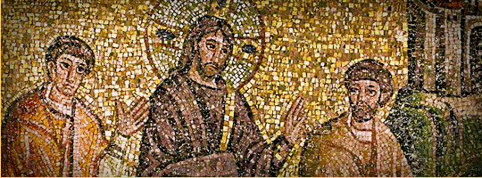
v. What Does Jesus’ being Our “Great High Priest” Mean for Us?

Slide 118
V. What does This Mean For Us?

Slide 119
V. What does This Mean For Us?
Jesus saves to the uttermost (Heb 7:25)

Slide 120
  Consequently, he is able to save to the uttermost those who draw near to God through him, since he always lives to make intercession for them.
  (Hebrews 7:25 ESV)

Slide 121
V. What does This Mean For Us?
Jesus saves to the uttermost (Heb 7:25)
  It has been paid

Slide 122
V. What does This Mean For Us?
Jesus saves to the uttermost (Heb 7:25)
  It has been paid
  See what it has cost

Slide 123
V. What does This Mean For Us?
Jesus saves to the uttermost (Heb 7:25)
  It has been paid
  See what it has cost
  Rejoice in what the Lord has done for you

Slide 124
V. What does This Mean For Us?
Jesus saves to the uttermost (Heb 7:25)
  It has been paid
  See what it has cost
  Rejoice in what the Lord has done for you
Jesus is praying for us (Heb 7:25)

Slide 125
V. What does This Mean For Us?
Jesus saves to the uttermost (Heb 7:25)
  It has been paid
  See what it has cost
  Rejoice in what the Lord has done for you
Jesus is praying for us (Heb 7:25)
Jesus can sympathize with us (Heb 4:15)

Slide 126
  For we do not have a high priest who is unable to sympathize with our weaknesses, but one who in every respect has been tempted as we are, yet without sin.
  (Hebrews 4:15 ESV)

Slide 127
V. What does This Mean For Us?
Jesus saves to the uttermost (Heb 7:25)
  It has been paid
  See what it has cost
  Rejoice in what the Lord has done for you
Jesus is praying for us (Heb 7:25)
Jesus can sympathize with us (Heb 4:15)
You only need one mediator (1 Tim 2:5)

Slide 128
V. What does This Mean For Us?
Jesus saves to the uttermost (Heb 7:25)
  It has been paid
  See what it has cost
  Rejoice in what the Lord has done for you
Jesus is praying for us (Heb 7:25)
Jesus can sympathize with us (Heb 4:15)
You only need one mediator (1 Tim 2:5)
Jesus brings us to God: Let us draw near with a true heart in full assurance of faith (Heb 10:22)

Slide 129
  let us draw near with a true heart in full assurance of faith, with our hearts sprinkled clean from an evil conscience and our bodies washed with pure water.
  (Hebrews 10:22 ESV)

Slide 130
V. What does This Mean For Us?
Jesus saves to the uttermost (Heb 7:25)
  It has been paid
  See what it has cost
  Rejoice in what the Lord has done for you
Jesus is praying for us (Heb 7:25)
Jesus can sympathize with us (Heb 4:15)
You only need one mediator (1 Tim 2:5)
Jesus brings us to God: Let us draw near with a true heart in full assurance of faith (Heb 10:22)
The Lord’s Supper comes alive (Luke 22:14-23)

Slide 131
V. What does This Mean For Us?
Jesus saves to the uttermost (Heb 7:25)
  It has been paid
  See what it has cost
  Rejoice in what the Lord has done for you
Jesus is praying for us (Heb 7:25)
Jesus can sympathize with us (Heb 4:15)
You only need one mediator (1 Tim 2:5)
Jesus brings us to God: Let us draw near with a true heart in full assurance of faith (Heb 10:22)
The Lord’s Supper comes alive (Luke 22:14-23)
You understand what it means to be a royal priesthood (1 Pet 2:9)

Slide 132
  But you are a chosen race, a royal priesthood, a holy nation, a people for his own possession, that you may proclaim the excellencies of him who called you out of darkness into his marvelous light.
  (1 Peter 2:9 ESV)

Slide 133
V. What does This Mean For Us?
Jesus saves to the uttermost (Heb 7:25)
  It has been paid
  See what it has cost
  Rejoice in what the Lord has done for you
Jesus is praying for us (Heb 7:25)
Jesus can sympathize with us (Heb 4:15)
You only need one mediator (1 Tim 2:5)
Jesus brings us to God: Let us draw near with a true heart in full assurance of faith (Heb 10:22)
The Lord’s Supper comes alive (Luke 22:14-23)
You understand what it means to be a royal priesthood (1 Pet 2:9)
  You are ministers of reconciliation (1 Cor 5:17-21)

Slide 134
  Therefore, if anyone is in Christ, he is a new creation. The old has passed away; behold, the new has come. All this is from God, who through Christ reconciled us to himself and gave us the ministry of reconciliation; that is, in Christ God was reconciling the world to himself, not counting their trespasses against them, and entrusting to us the message of reconciliation. Therefore, we are ambassadors for Christ, God making his appeal through us. We implore you on behalf of Christ, be reconciled to God. For our sake he made him to be sin who knew no sin, so that in him we might become the righteousness of God.
  (2 Corinthians 5:17-21 ESV)

Slide 135
V. What does This Mean For Us?
Jesus saves to the uttermost (Heb 7:25)
  It has been paid
  See what it has cost
  Rejoice in what the Lord has done for you
Jesus is praying for us (Heb 7:25)
Jesus can sympathize with us (Heb 4:15)
You only need one mediator (1 Tim 2:5)
Jesus brings us to God: Let us draw near with a true heart in full assurance of faith (Heb 10:22)
The Lord’s Supper comes alive (Luke 22:14-23)
You understand what it means to be a royal priesthood (1 Pet 2:9)
  You are ministers of reconciliation (1 Cor 5:17-21)
  You are called to be spotless (Eph 5:25-27; 1 Tim 6:13-14; 2 Pet 3:13-14)

Slide 136
  But according to his promise we are waiting for new heavens and a new earth in which righteousness dwells. Therefore, beloved, since you are waiting for these, be diligent to be found by him without spot or blemish, and at peace.
  (2 Peter 3:13-14 ESV)

Slide 137
Bow Down and Worship: For this is Your God

Slide 138
  Therefore, brothers, since we have confidence to enter the holy places by the blood of Jesus, by the new and living way that he opened for us through the curtain, that is, through his flesh, and since we have a great priest over the house of God, let us draw near with a true heart in full assurance of faith, with our hearts sprinkled clean from an evil conscience and our bodies washed with pure water.
  (Hebrews 10:19-22 ESV)

