Slide 1
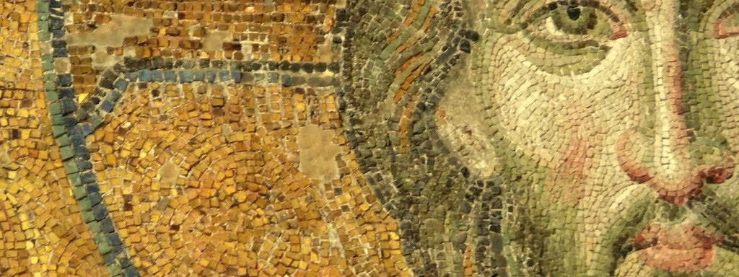
The Fullness of Christ:
Meditations on Our Multidimensional Messiah

Slide 2
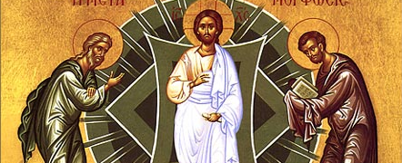
Lesson Four: Jesus, the Better Prophet

Slide 3
What Is the office of Christ?

Slide 4
I. Introduction:
What is the office of Christ?

Slide 5
I. Introduction:
What is the office of Christ?
  Historically, theologians—building out of the NT—have conceptualized the work of Christ in terms of his atonement and his “office.”

Slide 6
I. Introduction:
What is the office of Christ?
  Historically, theologians—building out of the NT—have conceptualized the work of Christ in terms of his atonement and his “office.”
  His office, therefore, describes Jesus’ messianic work—what he does as the messiah

Slide 7
I. Introduction:
What is the office of Christ?
  Historically, theologians—building out of the NT—have conceptualized the work of Christ in terms of his atonement and his “office.”
  His office, therefore, describes Jesus’ messianic work—what he does as the messiah
  His messianic office is Three-fold:

Slide 8
I. Introduction:
What is the office of Christ?
  Historically, theologians—building out of the NT—have conceptualized the work of Christ in terms of his atonement and his “office.”
  His office, therefore, describes Jesus’ messianic work—what he does as the messiah
  His messianic office is Three-fold:
    Jesus as Prophet

Slide 9
I. Introduction:
What is the office of Christ?
  Historically, theologians—building out of the NT—have conceptualized the work of Christ in terms of his atonement and his “office.”
  His office, therefore, describes Jesus’ messianic work—what he does as the messiah
  His messianic office is Three-fold:
    Jesus as Prophet
    Jesus as Priest

Slide 10
I. Introduction:
What is the office of Christ?
  Historically, theologians—building out of the NT—have conceptualized the work of Christ in terms of his atonement and his “office.”
  His office, therefore, describes Jesus’ messianic work—what he does as the messiah
  His messianic office is Three-fold:
    Jesus as Prophet
    Jesus as Priest
    Jesus as King

Slide 11
I. Introduction:
What is the office of Christ?
Why does the office of Christ matter?

Slide 12
I. Introduction:
What is the office of Christ?
Why does the office of Christ matter?
  Who Jesus is and what Jesus does are inseparable

Slide 13
I. Introduction:
What is the office of Christ?
Why does the office of Christ matter?
  Who Jesus is and what Jesus does are inseparable
    If we want to know Jesus in his fullness we need to know who he is and also what he does

Slide 14
I. Introduction:
What is the office of Christ?
Why does the office of Christ matter?
  Who Jesus is and what Jesus does are inseparable
  Understanding the three-fold office of Christ helps us grasp the comprehensive nature of what Jesus has accomplished

Slide 15
I. Introduction:
What is the office of Christ?
Why does the office of Christ matter?
  Who Jesus is and what Jesus does are inseparable
  Understanding the three-fold office of Christ helps us grasp the comprehensive nature of what Jesus has accomplished
  It also helps us put our Bibles together as the three divine representatives in the Old Testament find their fulfillment in Jesus

Slide 16
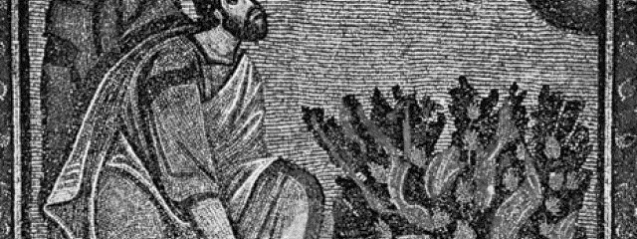
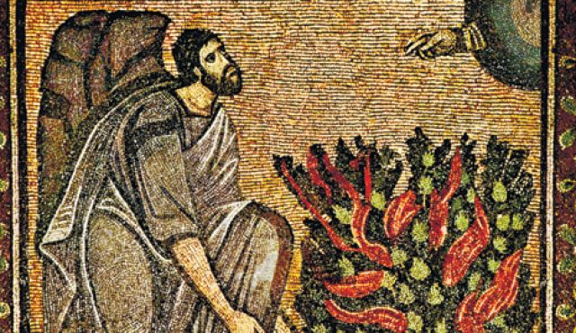
ii. Old Testament Background:
What is a Prophet?

Slide 17
ii. What is a Prophet?:
OT Definition:

Slide 18
ii. What is a Prophet?:
OT Definition:
  A prophet is one who represents God in the world

Slide 19

  Now obey my voice; I will give you advice, and God be with you! You shall represent the people before God and bring their cases to God
  (Exodus 18:19 ESV)

Slide 20
ii. What is a Prophet?:
OT Definition:
  A prophet is one who represents God in the world
  A prophet is one who proclaims God’s message

Slide 21
  The word that came to Jeremiah from the LORD: “Stand in the gate of the LORD's house, and proclaim there this word, and say, Hear the word of the LORD, all you men of Judah who enter these gates to worship the LORD. Thus says the LORD of hosts, the God of Israel: Amend your ways and your deeds, and I will let you dwell in this place. Do not trust in these deceptive words: ‘This is the temple of the LORD, the temple of the LORD, the temple of the LORD.’
  (Jeremiah 7:1-4 ESV)

Slide 22
ii. What is a Prophet?:
OT Definition:
  A prophet is one who represents God in the world
  A prophet is one who proclaims God’s message
  A prophet is one who declares and foretells the future:

Slide 23
Thus says the LORD to his anointed, to Cyrus, whose right hand I have grasped, to subdue nations before him and to loose the belts of kings, to open doors before him that gates may not be closed
(Isaiah 45:1 ESV) (700-680 BC)
“Thus says Cyrus king of Persia, ‘The LORD, the God of heaven, has given me all the kingdoms of the earth, and he has charged me to build him a house at Jerusalem, which is in Judah. Whoever is among you of all his people, may the LORD his God be with him. Let him go up.’”
(2 Chronicles 36:23 ESV) (539 BC)

Slide 24
ii. What is a Prophet?:
OT Definition:
  A prophet is one who represents God in the world
  A prophet is one who proclaims God’s message
  One who declares and foretells the future
  Summary:

Slide 25
ii. What is a Prophet?:
OT Definition:
  A prophet is one who represents God in the world
  A prophet is one who proclaims God’s message
  One who declares and foretells the future
  Summary:
    Prophets declare God’s truth

Slide 26
ii. What is a Prophet?:
OT Definition:
  A prophet is one who represents God in the world
  A prophet is one who proclaims God’s message
  One who declares and foretells the future
  Summary:
    Prophets declare God’s truth
    Prophets proclaim God’s view of the World

Slide 27
ii. What is a Prophet?:
OT Definition:
OT Prophetic Prediction:

Slide 28
“The LORD your God will raise up for you a prophet like me from among you, from your brothers—it is to him you shall listen—just as you desired of the LORD your God at Horeb on the day of the assembly, when you said, ‘Let me not hear again the voice of the LORD my God or see this great fire any more, lest I die.’ And the LORD said to me, ‘They are right in what they have spoken. I will raise up for them a prophet like you from among their brothers. And I will put my words in his mouth, and he shall speak to them all that I command him.
(Deuteronomy 18:15-18 ESV)
Notes:
God promises a line of prophets who will speak to Israel on his behalf (cf. Jer. 1:7, 9, pertaining to Jeremiah’s ministry).
Moses speaks of himself as a prophet, the instrument of communicating God’s word to Israel (cf. Deut. 18:19; Ex. 7:1).
Nations listen (Deut. 18:14) to magicians, etc.;
Israel is to listen to God’s prophet (vv. 15, 19) rather than pagan means of revelation and guidance. On the voice of the Lord, see 5:23–28. a prophet like you. Now God speaks of Moses as a prophet and promises a future prophet like him for Israel. In the first century a.d., Jews expected a final prophet, whom NT writers identified as Jesus (Acts 3:22–24; 7:37; cf. John 1:21).

Slide 29
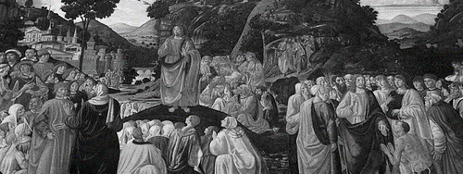
iiI. New Testament realities:
How is Jesus the Better Prophet?

Slide 30
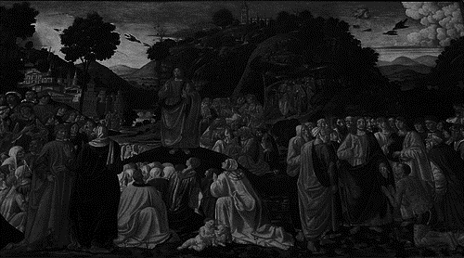
III. New Testament Realities:
Biblical Evidence: Jesus’ Prophetic Ministry

Slide 31
III. New Testament Realities:
Biblical Evidence: Jesus’ Prophetic Ministry
  The people recognizes Jesus’ Prophethood

Slide 32
  And the crowds said, “This is the prophet Jesus, from Nazareth of Galilee.”
  (Matthew 21:11 ESV)
  The woman said to him, “Sir, I perceive that you are a prophet. (John 4:19 ESV)
  So they said again to the blind man, “What do you say about him, since he has opened your eyes?” He said, “He is a prophet.”(John 9:17 ESV)

Slide 33
III. New Testament Realities:
Biblical Evidence: Jesus’ Prophetic Ministry
  The people recognizes Jesus’ Prophethood
  Jesus’ Prophetic Ministry is Unique:

Slide 34
III. New Testament Realities:
Biblical Evidence: Jesus’ Prophetic Ministry
  The people recognizes Jesus’ Prophethood
  Jesus’ Prophetic Ministry is Unique:
    Jesus declares his own Prophethood

Slide 35
At that very hour some Pharisees came and said to him, “Get away from here, for Herod wants to kill you.” And he said to them, “Go and tell that fox, ‘Behold, I cast out demons and perform cures today and tomorrow, and the third day I finish my course. Nevertheless, I must go on my way today and tomorrow and the day following, for it cannot be that a prophet should perish away from Jerusalem.’
(Luke 13:31-33 ESV)

Slide 36
And they took offense at him. But Jesus said to them, “A prophet is not without honor except in his hometown and in his own household.” And he did not do many mighty works there, because of their unbelief.
(Matthew 13:57-58 ESV)

Slide 37
III. New Testament Realities:
Biblical Evidence: Jesus’ Prophetic Ministry
  The people recognizes Jesus’ Prophethood
  Jesus’ Prophetic Ministry is Unique:
    Jesus declares his own Prophethood
    Jesus speaks and teaches with authority

Slide 38
And they were astonished at his teaching, for he taught them as one who had authority, and not as the scribes.
(Mark 1:22 ESV; cf. Matt 7:28-29)

Slide 39
And he went throughout all Galilee, teaching in their synagogues and proclaiming the gospel of the kingdom and healing every disease and every affliction among the people. So his fame spread throughout all Syria, and they brought him all the sick, those afflicted with various diseases and pains, those oppressed by demons, epileptics, and paralytics, and he healed them. And great crowds followed him from Galilee and the Decapolis, and from Jerusalem and Judea, and from beyond the Jordan.
(Matthew 4:23-25 ESV)

Slide 40
III. New Testament Realities:
Biblical Evidence: Jesus’ Prophetic Ministry
  The people recognizes Jesus’ Prophethood
  Jesus’ Prophetic Ministry is Unique:
    Jesus declares his own Prophethood
    Jesus speaks and teaches with authority
    All the prophets were looking forward to Jesus

Slide 41
Concerning this salvation, the prophets who prophesied about the grace that was to be yours searched and inquired carefully, inquiring what person or time the Spirit of Christ in them was indicating when he predicted the sufferings of Christ and the subsequent glories.
(1 Peter 1:10-11 ESV)

Slide 42
III. New Testament Realities:
Biblical Evidence: Jesus’ Prophetic Ministry
  The people recognizes Jesus’ Prophethood
  Jesus’ Prophetic Ministry is Unique:
    Jesus declares his own Prophethood
    Jesus speaks and teaches with authority
    All the prophets were looking forward to Jesus
    Jesus’ prophetic ministry is about himself and his kingdom:

Slide 43
III. New Testament Realities:
Biblical Evidence: Jesus’ Prophetic Ministry
  The people recognizes Jesus’ Prophethood
  Jesus’ Prophetic Ministry is Unique:
    Jesus declares his own Prophethood
    Jesus speaks and teaches with authority
    All the prophets were looking forward to Jesus
    Jesus’ prophetic ministry is about himself and his kingdom:
      Bread of life; Light of the world; I am from above; Before Abraham was, I Am; Gate for the Sheep; Good Shepherd; Resurrection and the Life; The way, the truth, the life; True Vine

Slide 44
III. New Testament Realities:
Biblical Evidence: Jesus’ Prophetic Ministry
Jesus is the Promised Better Prophet

Slide 45
III. New Testament Realities:
Biblical Evidence: Jesus’ Prophetic Ministry
Jesus is the Promised Better Prophet
  The people understood Jesus to be the Better Prophet

Slide 46
  When the people saw the sign that he had done, they said, “This is indeed the Prophet who is to come into the world!”
  (John 6:14 ESV; 7:40-41 (cf. John 1:20-21))

Slide 47
III. New Testament Realities:
Biblical Evidence: Jesus’ Prophetic Ministry
Jesus is the Promised Better Prophet
  The people understood Jesus to be the Better Prophet
  Peter declares Christ the fulfillment of Moses’ Promise

Slide 48
  Acts 3:17-26
Notes:
Peter in the Temple Square(cf. Acts 7:37)
Peter quotes Deut. 18:15 to show that Jesus was the prophet like Moses
In Acts 3:23 Peter quotes Deut. 18:19 to point out the danger of rejecting Jesus as this prophet

Slide 49
III. New Testament Realities:
Biblical Evidence: Jesus’ Prophetic Ministry
Jesus is the Promised Better Prophet
  The people understood Jesus to be the Better Prophet
  Peter declares Christ the fulfillment of Moses’ Promise
  Hebrews: Jesus as the Better Moses

Slide 50
  For Jesus has been counted worthy of more glory than Moses—as much more glory as the builder of a house has more honor than the house itself. (For every house is built by someone, but the builder of all things is God.) Now Moses was faithful in all God's house as a servant, to testify to the things that were to be spoken later, but Christ is faithful over God's house as a son. And we are his house if indeed we hold fast our confidence and our boasting in our hope.
  (Hebrews 3:3-6 ESV)

Slide 51
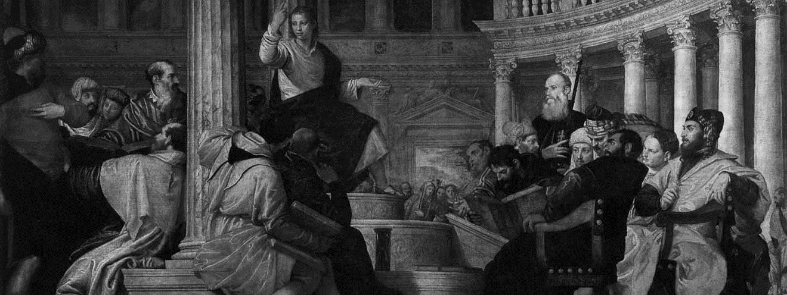
iV. Theological Significance:
Why is Jesus the Better Prophet?

Slide 52
IV. Theological Significance:
Christ represents God in the world

Slide 53
  John 1:1-14

Slide 54
IV. Theological Significance:
Christ represents God in the world
  John 1:14: Jesus is the Word of God
    Word: God’s Word is Jesus
    God’s Word is made effective in Jesus
    God’s Word provides relationship and revelation through Jesus
    God’s Word is the way to salvation through Jesus

Slide 55
IV. Theological Significance:
Christ represents God in the world
  John 1:14: Jesus is the Word of God
    Word: God’s Word is Jesus
    John 14:7
    Hebrews 1:3

Slide 56
  If you had known me, you would have known my Father also. From now on you do know him and have seen him.” (John 14:7 ESV)
  He is the radiance of the glory of God and the exact imprint of his nature, and he upholds the universe by the word of his power.
  (Hebrews 1:3 ESV)

Slide 57
IV. Theological Significance:
Christ represents God in the world
Christ proclaims God’s message in word

Slide 58
  I have much to say about you and much to judge, but he who sent me is true, and I declare to the world what I have heard from him.” They did not understand that he had been speaking to them about the Father. So Jesus said to them, “When you have lifted up the Son of Man, then you will know that I am he, and that I do nothing on my own authority, but speak just as the Father taught me.
  (John 8:26-28 ESV)
Notes:
Peter in the Temple Square(cf. Acts 7:37)
Peter quotes Deut. 18:15 to show that Jesus was the prophet like Moses
In Acts 3:23 Peter quotes Deut. 18:19 to point out the danger of rejecting Jesus as this prophet

Slide 59
  For I have not spoken on my own authority, but the Father who sent me has himself given me a commandment—what to say and what to speak. And I know that his commandment is eternal life. What I say, therefore, I say as the Father has told me.”
  (John 12:49-50 ESV)

Slide 60
IV. Theological Significance:
Christ represents God in the world
Christ proclaims God’s message in word
Christ proclaims God’s message in word and deed

Slide 61
IV. Theological Significance:
Christ represents God in the world
Christ proclaims God’s message in word
Christ proclaims God’s message in word and deed
  Jesus’ prophetic ministry is also done through his actions

Slide 62
IV. Theological Significance:
Christ represents God in the world
Christ proclaims God’s message in word
Christ proclaims God’s message in word and deed
  Jesus’ prophetic ministry is also done through his actions
    OT Background: Action as Prophetic Message

Slide 63
  At that time the LORD spoke by Isaiah the son of Amoz, saying, “Go, and loose the sackcloth from your waist and take off your sandals from your feet,” and he did so, walking naked and barefoot. Then the LORD said, “As my servant Isaiah has walked naked and barefoot for three years as a sign and a portent against Egypt and Cush, so shall the king of Assyria lead away the Egyptian captives and the Cushite exiles, both the young and the old, naked and barefoot, with buttocks uncovered, the nakedness of Egypt.
  (Isaiah 20:2-4 ESV,
  cf. Jeremiah 19:1-11; Hosea 1:2-9)

Slide 64
IV. Theological Significance:
Christ represents God in the world
Christ proclaims God’s message in word
Christ proclaims God’s message in word and deed
  Jesus’ prophetic ministry is also done through his actions
    OT Background: Action as Prophetic Message
    Jesus’ work as prophetic message

Slide 65
IV. Theological Significance:
Christ represents God in the world
Christ proclaims God’s message in word
Christ proclaims God’s message in word and deed
  Jesus’ prophetic ministry is also done through his actions
    OT Background: Action as Prophetic Message
    Jesus’ work as prophetic message
      Work of the Cross

Slide 66
  Then Jesus told his disciples, “If anyone would come after me, let him deny himself and take up his cross and follow me.
  (Matthew 16:24 ESV)

Slide 67
IV. Theological Significance:
Christ represents God in the world
Christ proclaims God’s message in word
Christ proclaims God’s message in word and deed
  Jesus’ prophetic ministry is also done through his actions
    OT Background: Action as Prophetic Message
    Jesus’ work as prophetic message
      Work of the Cross
      Work of the Servant

Slide 68
  But Jesus called them to him and said, “You know that the rulers of the Gentiles lord it over them, and their great ones exercise authority over them. It shall not be so among you. But whoever would be great among you must be your servant, and whoever would be first among you must be your slave, even as the Son of Man came not to be served but to serve, and to give his life as a ransom for many.”
  (Matthew 20:25-28 ESV)

Slide 69


Slide 70
IV. Theological Significance:
Christ represents God in the world
Christ proclaims God’s message in word
Christ proclaims God’s message in word and deed
  Jesus’ prophetic ministry is also done through his actions
    OT Background: Action as Prophetic Message
    Jesus’ work as prophetic message
      Work of the Cross
      Work of the Servant
      Jesus as Example

Slide 71
  For I have given you an example, that you also should do just as I have done to you. Truly, truly, I say to you, a servant is not greater than his master, nor is a messenger greater than the one who sent him.
  (John 13:15-16 ESV)
Notes:
See also 1 Cor 11:1; Eph 5;1-2; Col 3:13; 1 Pet 2:2-22; 1 John 2:6; 1 John 3:15-16

Slide 72
IV. Theological Significance:
Christ represents God in the world
Christ proclaims God’s message in word
Christ proclaims God’s message in word and deed
Christ proclaims God’s message of the future

Slide 73
IV. Theological Significance:
Christ represents God in the world
Christ proclaims God’s message in word
Christ proclaims God’s message in word and deed
Christ proclaims God’s message of the future
  Biblical Example: Luke 19:41-44

Slide 74
  And when he drew near and saw the city, he wept over it, saying, “Would that you, even you, had known on this day the things that make for peace! But now they are hidden from your eyes. For the days will come upon you, when your enemies will set up a barricade around you and surround you and hem you in on every side and tear you down to the ground, you and your children within you. And they will not leave one stone upon another in you, because you did not know the time of your visitation.”
  (Luke 19:41-44 ESV; cf. Matt 24-25)
Notes:
See also 1 Cor 11:1; Eph 5;1-2; Col 3:13; 1 Pet 2:2-22; 1 John 2:6; 1 John 3:15-16
Peter quotes Deut. 18:15 to show that Jesus was the prophet like Moses
In Acts 3:23 Peter quotes Deut. 18:19 to point out the danger of rejecting Jesus as this prophet

Slide 75
IV. Theological Significance:
Christ represents God in the world
Christ proclaims God’s message in word
Christ proclaims God’s message in word and deed
Christ proclaims God’s message of the future
  Biblical Example: Luke 19:41-44
  Christ’s proclamation of God’s message of the future surpasses all other prophets because:

Slide 76
IV. Theological Significance:
Christ represents God in the world
Christ proclaims God’s message in word
Christ proclaims God’s message in word and deed
Christ proclaims God’s message of the future
  Biblical Example: Luke 19:41-44
  Christ’s proclamation of God’s message of the future surpasses all other prophets because:
    Jesus fulfills what has been promised

Slide 77
  For all the promises of God find their Yes in him. That is why it is through him that we utter our Amen to God for his glory.
  (2 Corinthians 1:20 ESV)

Slide 78
IV. Theological Significance:
Christ represents God in the world
Christ proclaims God’s message in word
Christ proclaims God’s message in word and deed
Christ proclaims God’s message of the future
  Biblical Example: Luke 19:41-44
  Christ’s proclamation of God’s message of the future surpasses all other prophets because:
    Jesus fulfills what has been promised
    Jesus fulfills his own prophetic announcement

Slide 79
  Mark 8:31-38

Slide 80
IV. Theological Significance:
Christ represents God in the world
Christ proclaims God’s message in word
Christ proclaims God’s message in word and deed
Christ proclaims God’s message of the future
  Biblical Example: Luke 19:41-44
  Christ’s proclamation of God’s message of the future surpasses all other prophets because:
    Jesus fulfills what has been promised
    Jesus fulfills his own prophetic announcement
    Jesus interprets his own prophetic revelation and work

Slide 81
  Some of those who were with us went to the tomb and found it just as the women had said, but him they did not see.” And he said to them, “O foolish ones, and slow of heart to believe all that the prophets have spoken! Was it not necessary that the Christ should suffer these things and enter into his glory?” And beginning with Moses and all the Prophets, he interpreted to them in all the Scriptures the things concerning himself.
  (Luke 24:24-27 ESV)

Slide 82
  Then he said to them, “These are my words that I spoke to you while I was still with you, that everything written about me in the Law of Moses and the Prophets and the Psalms must be fulfilled.” Then he opened their minds to understand the Scriptures, and said to them, “Thus it is written, that the Christ should suffer and on the third day rise from the dead, and that repentance and forgiveness of sins should be proclaimed in his name to all nations, beginning from Jerusalem. You are witnesses of these things. And behold, I am sending the promise of my Father upon you. But stay in the city until you are clothed with power from on high.”
  (Luke 24:44-49 ESV)

Slide 83
IV. Theological Significance:
Christ represents God in the world
Christ proclaims God’s message in word
Christ proclaims God’s message in word and deed
Christ proclaims God’s message of the future
  Biblical Example: Luke 19:41-44
  Christ’s proclamation of God’s message of the future surpasses all other prophets because:
    Jesus fulfills what has been promised
    Jesus fulfills his own prophetic announcement
    Jesus interprets his own prophetic revelation and work
    Jesus prophetically declares the inauguration of the future promises of God

Slide 84
  From that time Jesus began to preach, saying, “Repent, for the kingdom of heaven is at hand.”
  (Matthew 4:17 ESV)

Slide 85
  And he said to them, “When you pray, say: “Father, hallowed be your name. Your kingdom come.
  (Luke 11:2 ESV; cf. Matt 7:21-23)

Slide 86
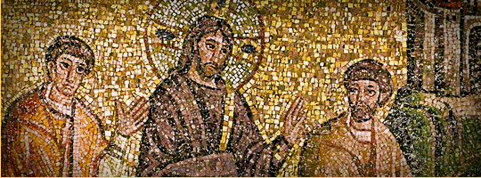
v. What Does Jesus’ being the “Better Prophet” Mean for Us?

Slide 87
V. What does This Mean For Us?
Jesus is the Word of God for Us

Slide 88
V. What does This Mean For Us?
Jesus is the Word of God for Us
Jesus is what all the promises of the OT point to for fulfillment

Slide 89
V. What does This Mean For Us?
Jesus is the Word of God for Us
Jesus is what all the promises of the OT point to for fulfillment
Jesus is what all the promises of the NT point to for fulfillment

Slide 90
V. What does This Mean For Us?
Jesus is the Word of God for Us
Jesus is what all the promises of the OT point to for fulfillment
Jesus is what all the promises of the NT point to for fulfillment
Jesus is our Example

Slide 91
V. What does This Mean For Us?
Jesus is the Word of God for Us
Jesus is what all the promises of the OT point to for fulfillment
Jesus is what all the promises of the NT point to for fulfillment
Jesus is our Example
Everything that Jesus says and does reveals God to us

Slide 92
V. What does This Mean For Us?
Jesus is the Word of God for Us
Jesus is what all the promises of the OT point to for fulfillment
Jesus is what all the promises of the NT point to for fulfillment
Jesus is our Example
Everything that Jesus says and does reveals God to us
In Jesus—his threefold office—we have everything we need

Slide 93
V. What does This Mean For Us?
Jesus is the Word of God for Us
Jesus is what all the promises of the OT point to for fulfillment
Jesus is what all the promises of the NT point to for fulfillment
Jesus is our Example
Everything that Jesus says and does reveals God to us
In Jesus—his threefold office—we have everything we need
Jesus’ Prophetic Ministry is a basis for our Christian Life

Slide 94
V. What does This Mean For Us?
Jesus is the Word of God for Us
Jesus is what all the promises of the OT point to for fulfillment
Jesus is what all the promises of the NT point to for fulfillment
Jesus is our Example
Everything that Jesus says and does reveals God to us
In Jesus—his threefold office—we have everything we need
Jesus’ Prophetic Ministry is a basis for our Christian Life
  1. His teaching and interpretation is available

Slide 95
V. What does This Mean For Us?
Jesus is the Word of God for Us
Jesus is what all the promises of the OT point to for fulfillment
Jesus is what all the promises of the NT point to for fulfillment
Jesus is our Example
Everything that Jesus says and does reveals God to us
In Jesus—his threefold office—we have everything we need
Jesus’ Prophetic Ministry is a basis for our Christian Life
  1. His teaching and interpretation is available
  2. His life is exemplary

Slide 96
V. What does This Mean For Us?
Jesus is the Word of God for Us
Jesus is what all the promises of the OT point to for fulfillment
Jesus is what all the promises of the NT point to for fulfillment
Jesus is our Example
Everything that Jesus says and does reveals God to us
In Jesus—his threefold office—we have everything we need
Jesus’ Prophetic Ministry is a basis for our Christian Life
  1. His teaching and interpretation is available
  2. His life is exemplary
  3. His prophetic act of death and resurrection is my hope

Slide 97
V. What does This Mean For Us?
Jesus is the Word of God for Us
Jesus is what all the promises of the OT point to for fulfillment
Jesus is what all the promises of the NT point to for fulfillment
Jesus is our Example
Everything that Jesus says and does reveals God to us
In Jesus—his threefold office—we have everything we need
Jesus’ Prophetic Ministry is a basis for our Christian Life
  1. His teaching and interpretation is available
  2. His life is exemplary
  3. His prophetic act of death and resurrection is my hope
  4. His prophetic kingdom is here and is coming

Slide 98
V. What does This Mean For Us?
Jesus is the Word of God for Us
Jesus is what all the promises of the OT point to for fulfillment
Jesus is what all the promises of the NT point to for fulfillment
Jesus is our Example
Everything that Jesus says and does reveals God to us
In Jesus—his threefold office—we have everything we need
Jesus’ Prophetic Ministry is a basis for our Christian Life
  1. His teaching and interpretation is available
  2. His life is exemplary
  3. His prophetic act of death and resurrection is my hope
  4. His prophetic kingdom is here and is coming
  5. His prophetic future promises are my desire

